Slide 1

Mental Health Management After Concussion
Ross Davidson, MD, FRCPC
Physical Medicine and Rehabilitation
Concussion Management ‘The New Science’ CME
September 27th 2018
Notes:
Marjo Deprezi

Slide 2
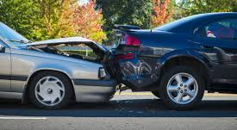
M. Deprezi
Notes:
52 year old male, post graduate education, technician at VIU, job involves cognitively demanding work, medical history of previous concussion, viral encephalitis in 20’s, appendectomy, right radial fracture with ORIF, restless leg syndrome, OSA, Tinnitus. Allery to penicillin, only meds pramipexole and naproxen PRN. Rear ender MVA, from a complete stop, car pushed forward 5 feet, brief loss of consciousness, post traumatic amnesia of minutes, bizzare behaviour afterward, confused. Main complaints were headaches, poor cognitive function, poor sleep quality, generalized worry about all aspects of life (work, relationships, kids, recreation, reports attacks of severe physical symptoms including headaches, sensitivities, heart racing, increased breathing rate and an overwhelming sense of anxiety). Reports anhedonia, reduced energy, concentration, overeating, (gained 30lb over 3 years), passive suicidal ideation, outbursts of anger when overwhelmed (no physical outbursts).
Exam, 6’4, 250lb. Slow responses, sensitive to lights in the room, teary, emotional. Abnormal, imbalanced gait esp. when standing on left leg, Neurological examination normal, MSK neck decreased range of motion with ++ pain, ++ myofascial tenderness.

Slide 3
Poor sleep
Cognitive Symptoms
Emotional Symptoms
Physical Symptoms

Slide 4



Sleep Disorders
Cognitive Symptoms
Mood Disorders
Pain Disorders

Slide 5
Sleep Disorders
Cognitive Symptoms
Mood Disorders
Pain Disorders

Slide 6
Sleep Disorders
Cognitive Symptoms
Mood Disorders
Pain Disorders
Notes:
General considerations
Special contributors: Scott McCullagh, Robert van Reekum & Diana Velikonja
Mental health disorders are common following mTBI, and appear to be major determinants of post-mTBI wellness and functional recovery. This includes disorders of mood which consist of symptoms related to depression and anxiety. The etiology of mTBI/concussive mood disorders may be related to reactive or environmental factors such as the experience of the trauma resulting in the injury (e.g., manifesting in post-traumatic stress symptoms, phobias and related anxieties) or to the negative outcomes following the injury (i.e., depression related to not participating in important roles such as work or school, sports, etc.) They may also manifest in response to the chronic symptoms that can follow concussion/mTBI or any physical injuries such as poor sleep, persistent headaches, chronic pain, medications, etc. Indeed, all of these types of outcomes can contribute, causally, to distress and to disorders of mood. Reciprocally, in what can be considered a ‘vicious cycle of pathology’, disorders of mood can exacerbate chronic pain, sleep disturbance, anergia and cognitive inefficiencies. This approach to considering disorders of mental health is important when attempting to holistically assess for and manage an individual’s outcomes post-mTBI. The disorders of mood related to increased irritability, intolerance, reduced patience and mood reactivity may be related to the neurobiological impact of the injury and/or a reaction to challenges of managing stimulation early on following the injury.
Mental health symptoms and outcomes must be understood within the biopsychosocial context of the individual and that multiple factors can influence related mental health disorders. In the case of mTBI, biologically the individual may suffer an insult to the brain and injuries to the body (e.g., whiplash injuries, etc.), with consequences to their experience of pain and ability to sleep, which can further cause changes in the neurobiology of the brain. At the psychological level they may experience acute stress due to their experience of trauma or injury, as well as in response to the consequences to their functional abilities resulting from the injury. People with persistent symptoms may become isolated from others as they may be intolerant of or unable to engage in social interactions. Their injury status may disrupt their occupational status, leisure activities and interpersonal interactions. They may also incur losses (e.g., reduced quality of life and independence; lowered income or reduced educational attainment; changes in relationship functioning, etc.). When assessing and managing disorders of mental health post mTBI, it is important to consider all of these potential factors; additionally, individuals who have suffered an mTBI may also have a pre-existing history of biopsychosocial factors/issues that may affect the expression of mental health symptoms or the duration of recovery including the ability to return to pre-injury status.
It is often difficult to obtain timely assessments and treatment interventions from mental health experts. Delays can, and often do, contribute to worse outcomes, and so it is important that primary care providers intervene as soon as possible. Screening for mental health symptoms and determining their etiology as well as prescribing treatment is crucial to facilitating a positive recovery. For example, in a primary care setting this may include screening for disturbances of sleep, or presence of chronic pain, loss, metabolic status etc when patients report low affect. Intervening at the level of improving sleep, managing pain and correcting metabolic imbalances may result in improving reports of low affect. If psychological and social issues appear to be causing mental health symptoms then appropriate therapeutic and/or medication strategies should be employed.
Finally, there is no current evidence to indicate that the mental health problems of individuals who have suffered an mTBI should be treated any differently than mental health problems of other etiologies. For example, we do not have evidence that Major Depressive Disorder (MDD) post-mTBI should be treated differently than MDD that may develop for other psychosocial or biological factors. As such, pharmacological and nonpharmacological interventions including therapeutic interventions that have been found to be helpful in the general population should be considered for individuals who have developed mental health problems post mTBI. Strategies used to treat mental health symptoms post concussion/mTBI should follow the same logic as that applied to similar symptoms found secondary to their conditions or circumstances which include the potential for treatments to worsen other mTBI outcomes. For example, some antidepressant medications, particularly those that are more sedating and/or have greater anticholinergic activity, can worsen the anergia and cognitive impairments that arise directly from mTBI. Another example is the concern for exacerbating seizure risk; fortunately, seizures are a relatively rare outcome of mTBI (although one that must be considered and, depending on the history, assessed for when considering certain psychotropic medications). Some medications can also contribute to worsening of balance impairment, or dizziness, and other symptoms. The need, then, is to select treatment interventions for which there is some evidence of efficacy (often this will be derived from studies done in the non-mTBI population) while carefully considering and assessing for, the potential to exacerbate other mTBI-related outcomes. In general, psychotropic medications should be used with caution, and non-medication options selected as much as possible. If selecting a medication intervention, start at low doses, allow adequate time for response to be assessed for, and carefully monitor for both efficacy and side effects.

Slide 7

Symptom Treatment Hierarchy
  Primary Symptoms (address early)
    Mood disorder/irritability
    Sleep disorder
    Headache
  Secondary Symptoms (address after above)
    Balance
    Dizziness/vertigo
    Cognitive impairment
    Fatigue
    Tinnitus/noise intolerance
Sleep Disorders
Cognitive Symptoms
Mood Disorders
Pain Disorders
Notes:
Assessment
Acute concussive symptoms can include irritability, anxiety, emotional lability, depressed mood and apathy.1-3 Early education and treatment focused on symptom management is important. If symptoms persist, the risk of increasing symptom intensity is heightened manifesting in more severe mental health symptoms such as Major Depressive Disorder (MDD) and Post- Traumatic Stress Disorder (PTSD).4 Depressive disorders following TBI are commonly associated with increased irritability and often comorbid with anxiety symptoms as well as with fatigue, sleep disturbances, cognitive dysfunction, decreased mobility, emotional processing deficits and anxiety syndromes. The latter include generalized anxiety, panic attacks, phobic disorders, and post-traumatic stress disorder (PTSD).2,3,5 These disorders comprise both new conditions that develop de novo post-injury, as well as those reflecting an exacerbation of pre-injury conditions or vulnerabilities.1
Regardless of etiology these disorders require prompt recognition, identification and treatment, given their frequency and potential to impede recovery in other symptom domains1,6 as well as result in significant functional declines. Pre-existing difficulties such as substance use disorders and poor psychosocial adjustment also place patients at risk for a protracted recovery or a recovery that is much longer than expected.7-9 Females on average take longer to recover and are at higher risk for anxiety and depressive disorders after TBI.4,9,10 Delays in returning to social and vocational roles can in turn produce demoralization and worsened emotional symptoms.1,4,11

Slide 8
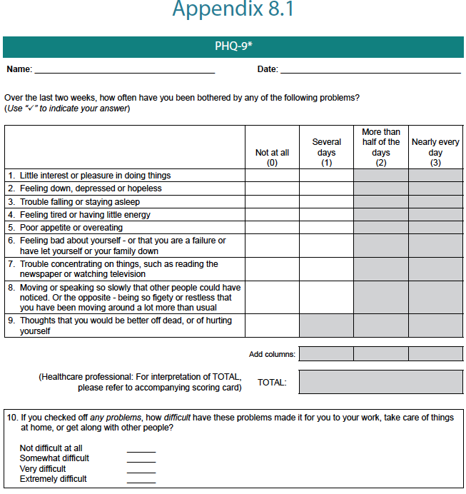
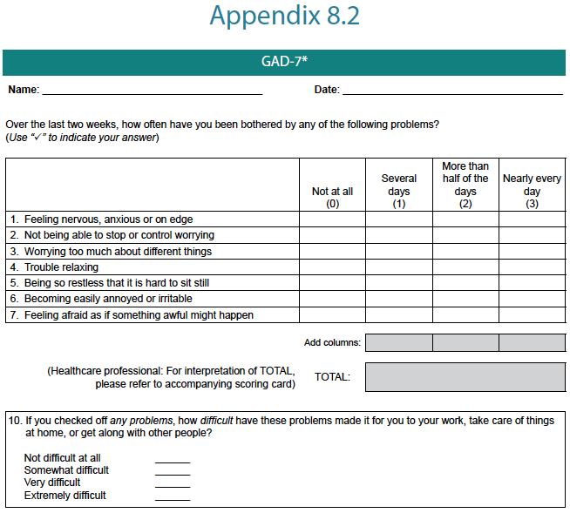
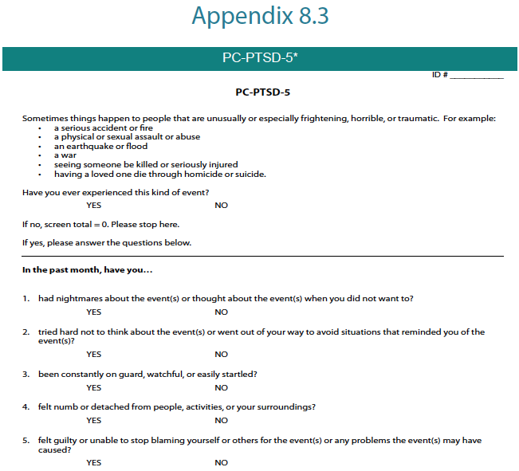
Assessment
Structured interview or standardized questionnaires with supplemental questions
Medical work up- Consider cardiorespiratory disease, stroke, MS, metabolic, or substance use disorders that co-exist with depression/anxiety/PTS
  CBC-d, electrolyte panel, Ur/Cr, TSH, B12, FG
Diagnosis
Notes:
The assessment of mental health disorders can be challenging given the overlap in symptoms between mood disorders, sleep disorders, pain syndromes, as well as cognitive difficulties. “Subthreshold” variants of certain conditions, particularly anxiety-based disorders such as PTSD are also observed, in which a symptom cluster falls short of meeting formal diagnostic criteria for a more commonly known disorder, but diagnostically fall into other trauma-related syndromes and require treatment. In general, it is recommended that DSM 5 diagnostic criteria be applied in an “inclusive” manner: for example, counting all relevant symptoms toward a potential diagnosis of depression, regardless of whether the mTBI alone could have caused the symptom12,13 Potential contributing medical conditions should also be identified, such as anemia, thyroid dysfunction, B12 deficiency, and so forth. If a mental health condition exists appropriate care should be provided or appropriate referrals made. In situations of diagnostic uncertainty, appropriate referrals should be made.

Slide 9
Management
Non-pharmocologic:
  CBT (evidence in mood disorders in TBI inc anxiety, depression, insomnia, chronic pain)
Pharmacologic:
  SSRIs are first line (Citalopram and sertraline have evidence in TBI) for depression, reduce anxiety, irritability, possibly improve cognition, somatic symptoms, psychosocial function
No specific studies for treatment of PTSD symptoms in mTBI literature
  In general PTSD literature, sertraline, paroxetine, venlafaxine.
Warn pt about side effects, patients tend to be very sensitive
Be wary of risk of post traumatic seizures. 1.5x (mild) increased risk
Indicated if symptoms cause distress and negatively affect function or quality of life.
Treat early to avoid symptoms becoming entrenched
Medical issues to be managed concurrently
Education:
  Expected outcome (nearly all improve!)
  Family support/involvement may be helpful
  Regular light (low impact) exercise
  Balanced meals
  Routine
  Seek social support
Notes:
Management
Treatment is indicated when symptom levels cause distress and negatively impact interactions, function and quality of life or clearly are impeding recovery. Once identified, appropriate psychological and/or pharmacological treatment should be initiated. Medication consultation can be provided by a psychiatrist while therapy interventions may be provided by psychologists or other mental health specialists. Treatment should be initiated early to reduce the risk of worsening symptoms and/or having symptoms become entrenched. Medical issues should be managed concurrently such as headaches, dizziness and comorbid pain. Immediate approaches should include concussion/mTBI education regarding the positive expectations for recovery as well as general support, validation and reassurance.14-17 Involvement of the family can be very helpful at this stage. Education about regular light exercise should be provided, as well as other important lifestyle information including balanced meals, keeping a routine, seeking social support, etc. General lifestyle measures can have some positive effect on mood, perceived fatigue and well-being, and can counteract deconditioning. See Algorithm 8.1, which outlines care pathways for mild to moderate and severe mental health disorders following concussion/mTBI.
Non-Pharmacological (Psychosocial) interventions
Psychological interventions are critical in the management of primary mental health disorders and include counselling and formal psychotherapies. Cognitive behavioural therapy (CBT) refers to a structured set of strategies focused on managing negative emotion and building coping strategies by altering maladaptive thought patterns and behaviour. There is robust support for the efficacy of this treatment across a range of mental health conditions which include those affecting individuals with concussion/mTBI (e.g., various types of depression and anxieties, insomnia, chronic pain, etc.) with some modifications in procedure indicated for individuals with cognitive challenges.9,17-19 The psychotherapeutic intervention applied should be appropriate for the mental health condition diagnosed post concussion/mTBI.20
The decision to recommend psychological intervention will depend on factors such as patient preference and motivation, symptom severity and comorbidity, skills and experience of the treating clinician, and the ease of access to such resources. Primary care providers may be well-suited to provide supportive counselling, along with low-intensity interventions based on CBT principles.21 For more difficult symptom presentations cases, such as moderate to severe depression or anxiety, persistent PTSD, or the presence of complex comorbities referral for specialist treatment should be sought. Combined treatment with medication may also be appropriate.
Pharmacological interventions
Medication may be required for those with moderate to severe, persistent depressive or anxiety symptoms. Selective serotonin reuptake inhibitors (SSRIs) and Serotonin norepinephrine reuptake inhibitors (SNRIs) are recommended as first-line treatments for diagnosed mental health conditions following concussion/mTBI, based upon their side-effect profile and broader utility when compared to agents from other classes.9,22 Current evidence supports the utility of SSRIs and SNRIs in treating depression, reducing anxiety and irritability, and, in some reports, improving cognition, somatic symptoms and psychosocial function.22 The efficacy and tolerability of both sertraline23 (starting at 25 mg; aiming for 50-200 mg/day) and citalopram (starting at 10 mg; aiming for 20-40 mg/day) is supported within the mTBI literature.1,24 Common clinical experience suggests that other agents (e.g., alternate SSRIs, venlafaxine, mirtazepine) may also be useful for diagnosed mental health conditions following mTBI, yet clinical data with these agents is lacking. There are no studies indicating specific medication treatment for PTSD for individuals with concussion/mTBI, yet the use of sertraline, paroxetine and venlafaxine are supported by high-quality evidence in the non-TBI population.22,25 In the absence of additional data specific to TBI, the use of treatment algorithms developed for primary mental health disorders may be appropriate, albeit with some qualifications.
The concussion/mTBI population may be more sensitive to adverse medication effects upon cognition (alertness, attention, memory), balance and dizziness, sleep and fatigue, and headaches. Anticholinergic effects of certain tricyclic medications (e.g., amitriptyline, imipramine, doxepin) should be carefully monitored. Although uncommon, the risk of post-traumatic seizures (epilepsy) after concussion/mTBI remains elevated and accounts for 10–20% of epilepsy cases in the general population26 at about 1.5 times the rate for the general population for 1-4 years after injury.10 Up to 86% of patients with one seizure after TBI will have a second seizure within 2 years of their injury.27 Medications with greater impact upon the seizure threshold, such as clomipramine, maprotiline, and the immediate-release formulation of bupropion, should be avoided in favour of newer agents.28 The use of benzodiazepines as first-line therapy or in the long-term treatment for anxiety, agitation or aggressiveness after concussion/mTBI is generally not recommended due to potential effects on arousal, cognition,
and motor coordination.24,29 The potential for abuse/dependency associated with these agents is also of concern, given the elevated rates of pre-injury substance use disorders observed among TBI patients.9,24 Nonetheless, short-term use of these agents may be helpful during periods of crisis or acute distress.
Strategies related to discontinuation of pharmacoptherapy should be based on guidelines appropriate to the diagnosed mental health condition. Special consideration is not currently indicated for concussion/mTBI.30 In the absence of strong reasons for early termination (such as tolerance issues), successful pharmacotherapy should be continued for at least 6 months before a trial of slow tapering is considered. Relapse prevention strategies should also be considered with psychological treatment approaches.

Slide 11


Conclusion
Notes:
Education- Headways app
Anxiety/depression- Suicide assessment (low risk), Escitalopram 5→10→20, CBT resources given, started with psychologist,
Cognitive- OT assessment for cognitive function, pacing strategies, work recommendations,
Physical- PT with Concussion experience
Neck pain/headaches- diclofenac gel, trigger point injection, education about posture
Imbalance- CT Spine to rule out CC narrowing, showed ML spondylosis, possible trigger for headaches

Slide 12

Ross Davidson, MD, FRCPC
Physical Medicine and Rehabilitation
Concussion Management ‘The New Science’ CME
September 27th 2018

Slide 13
L’Exhaustio Lutharges
Notes:
43 year old female, history of migraines insomnia and depression, motor vehicle accident, rear ended, brief loss of consciousness, confused afterward, taken by EMS to ER, diagnosed with whiplash and a concussion, given education, advice to rest and begin gentle physical activity 24-48h after the incident. Found that she slept all of the time, with need for naps during the day, sleep seems reasonably restorative. Medical issues associated with hypersomnia ruled out. Still remains fatigued. Mood worse, treated that, fatigues till persists, Migraines are worse trialed treatment for this, no better. What next?

Slide 14
Fatigue After Concussion: Epidemiology
Notes:
Fatigue has been conceptualized as an experience of weariness or tiredness following mental or physical exertion, often
resulting in a reduced capacity for work and limited efficiency to respond to stimuli. Fatigue can be caused by psychological
or physiological forces1 and can be central or peripheral, which in lay terms is experienced as cognitive fatigue and physical
fatigue or weariness.2-4
Fatigue is one of the most pervasive symptoms following concussion/mTBI, with 27.8% of individuals
experiencing persistent fatigue at 3 months post-injury.5 The perception of fatigue can be out of proportion to exertion or
may even occur without any exertion.6
One study reported a level of fatigue in patients with concussion/mTBI comparable to that of individuals with multiple sclerosis, a condition which is known to be associated with clinically-significant disease related fatigue levels.7 Fatigue is multidimensional and can affect physical, cognitive, motivational and psychological (i.e., depression, anxiety) spheres.8 Individuals with fatigue can experience poorer problem-solving and coping skills, which then increases stress, depression which creates an ongoing cycle that contributes to disability.7 For instance, a state of chronic stress may be present following mTBI, which compromises the biological stress system and increases the likelihood for fatigue and stress-related disorders.9 Fatigue following TBI has also been found to significantly impact well-being and quality of life, and is strongly associated with somatic symptoms and perceived situational stress.8,9

Slide 15

Fatigue After Concussion: Assessment
Medical interview, Rivermead PCQ, fatigue scales
Assess for secondary causes of fatigue
  Mood disorder, depression, anxiety
  Sleep disorder
  Metabolic disorders (hypothyroid, anemia, DM)
  Electrolyte d/o(hyponatremia, hypocalcemia)
  Polypharmacy
Notes:
Due to its prevalence and effects, it is recommended that all patients be assessed for fatigue through a personal history with the patient and/or support person. A review of the relevant items from the Rivermead Post Concussion Symptoms Scale (Appendix 1.5) and/or a specific measure of fatigue, such as the Barrow Neurological Institute (BNI) Fatigue Scale10 (Appendix 11.1). The Fatigue Severity Scale11 (Appendix F), the Fatigue Impact Scale12 (Appendix F ) or the Mental Fatigue
Scale13 (Appendix F ) can also assist with this.
History- Frequency, Intensity, Time of day, Aggravating factors
Sleep, Caffiene intake, Alcohol intake, other non-prescription drug use Cannabis intake,
Post-concussion/mTBI fatigue can be persistent and has been shown to still be present up to five years post-injury.8 Those who experience fatigue at three months post-injury are increasingly likely to continue to experience fatigue beyond six months post-injury.11 Due to the relationship between pituitary dysfunction, specifically growth hormone deficiency, and fatigue some have suggested a relation between the two; however recent literature has not found a significant relationship.14-16 As certain
medications can cause fatigue, the practitioner should also conduct a thorough review of the patient’s medications. If the patient has been prescribed a medication that is associated with fatigue, alternatives that produce the same treatment effect without inducing fatigue should be considered. A list of medications commonly associated with fatigue can be found in Appendix 11.2. As persistent fatigue may cause other symptoms to worsen, early intervention is required in order to prevent interference with the patient’s ability to participate in rehabilitation therapies.8,17 Patients should also be provided with advice on how to cope with fatigue (see Appendix 11.3), such as general stress management techniques.8 If debilitating fatigue persists, consider referral to an interdisciplinary concussion clinic.
Research into treating fatigue has revealed few studies varying from non-pharmacological to pharmacological treatment. Methylphenidate has been found to improve mental fatigue and processing speed in patients with persistent post-concussion symptoms,18,19 including up to 6 months post-treatment.20 Caution is recommended in the use of stimulants however; as clinical experience has identified that some individuals report that stimulants provide a burst of energy followed by increased fatigue. Some non-pharmacological treatments such as exercise (e.g., aquatic therapy), mindfulness-based stress reduction, cognitive behavioural therapy21 and blue-light therapy22 could potentially be helpful in treating fatigue however more research is needed.23

Slide 16
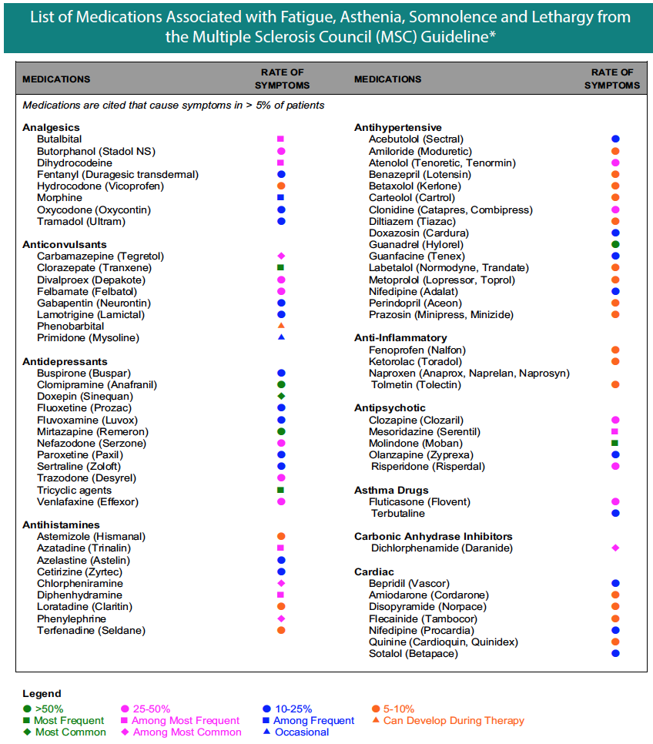
Fatigue After Concussion: Assessment
Medications commonly associated with fatigue
  Analgesics
    Narcotics, Neuropathic pain agents, muscle relaxants
  Antidepressants
    Mirtazepine, TCAs, Trazodone, Venlafaxine, buspirone, paroxetine, sertraline,
  Hypnotics (esp. benzodiazepines, clonazepam, diazepam)
  Antihistamines
  Antihypertensives (esp. beta blockers, clonidine, nifedipine)
  Antipsychotics (Risperidone, olanzapine)
Notes:
Medication review important, many medications used for sleep may result in hangovers during the day.
Prevalence of sleep disordered breathing is significant in the general population
Limited physical capacity through deconditioning also likely plays a role in fatigue

Slide 17
Fatigue after Concussion: Management
Manage comorbid medical conditions including mood disorders, pain, and sleep
Education about routine, sleep, low impact physical activity, substance effects on sleep and wakefulness
Consider adjusting medications that exacerbate fatigue
Non-pharmacologic strategies- gentle low impact, regular physical activity mindfulness based stress reduction, blue light therapy
‘Adaptive’ strategies- pacing, prioritization

Slide 18
Fatigue after Concussion: Pharmacologic Management
Methylphenidate
Notes:
51 participants, almost all mTBI, doing well physically, included because of fatigue, excluded people on ASA, lipid lowering medications blood pressure control medications, excluded people with severe pain, excluded people with suspected somatoform disorder, depression prior to trauma, personality disorder, females of child bearing age not on contraception, pregnancy, drug abuse, CAD, CHF or arrythmia.
Low dose:
5mg ODx1/52, 5mg BID x1/52, 5mg TIDx1/52
Normal dose:
10mgx2, 20,10,10x1/52, 20,20,10x1/52, 20 TID
Placebo:
4 weeks
MFS=Mental fatigue Scale
No serious adverse events, mild- w/d b/c increased blood pressure, amotivation, restlessness, depressive symptoms,
Side effects- Increased blood pressure, Tachycardia, insomnia,

Slide 19
Conclusion
Notes:
Given education/advice about gentle low impact physical activity, sleep hygeine and conservative strategies, reduction of alcohol and caffiene, blood-work for medical causes of fatigue were unremarkable, sleep disordered breathing ruled out. Methylphenidate contraindicated so not used. Life demands changed (switched part time), was able to manage fatigue better with OT help Pacing/Prioritization. Improved over years to participate in more recreational activities.

Slide 20
Summary
Fatigue after concussion is common
Comorbid mental health, sleep disorders to be treated
Look for comorbid medical issues and medications contributing to fatigue
Use non-pharmacologic strategies and ‘adaptations’ as first line
Methylphenidate has some evidence, but use in a select population is prudent

Slide 21
References
Marshall S, Bayley M ’Clinical practice guidelines for mild traumatic brain injury and persistent symptoms’ Can Fam Physician 2012 Mar, 58(3): 257-267. (3rd update 2017)
Johansson, B ‘Methylphenidate reduces mental fatigues and improves processing speed in persons suffered a traumatic brain injury’ Brain Inj. 2015; 29(6):758-765

