Slide 1
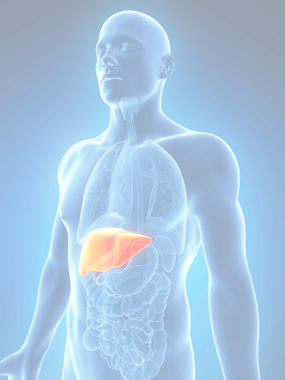
Fatty liver disease: How to risk stratify and why
Rohit Pai
MD, FRCPC
Gastroenterology and Hepatology
Island Health and Pacific Digestive Health
Clinical Assistant Professor, UBC
Liver Care Clinic, Royal Jubillee Hospital

Slide 2
Disclosures
Research: Intercept, BMS
Advisory board: Intercept, Lupin, Merck, AbbVie
Honoraria: AbbVie, Gilead, Celgene, Merck, BMS, GE, Amgen

Slide 3
Outline
Definitions - MAFLD
Risk of progression
Non invasive markers

Slide 4
Polling Questions:
Do you screen for NAFLD/NASH
How do you assess risk?
Yes
No
Labwork
Ultrasound
Non invasive serum tests: FIB4, NAFLD score, etc
Fibroscan/Elastography
Combination of above
None of the above

Slide 5
Common definitions
Non – alcoholic fatty liver disease (NAFLD)
  “Fatty liver on imaging”
  Umbrella term for a larger cluster of disorders
  Liver biopsy > 5% hepatic steatosis without inflammation
NAFLD + inflammation = Non-alcoholic steatohepatitis (NASH)
  Liver biopsy > 5% hepatic steatosis with inflammation
  Increased liver enzymes are characteristic clinical findings but can be normal
  Higher risk of progression of liver disease and cardiac risk

Slide 6
MAFLD: Metabolic Associated Fatty Liver Disease, a new definition

Slide 8
Why should we care about non-alcoholic fatty liver disease (NAFLD)?
1 in 4 adults have NAFLD
NASH 1.5-6.5% of the population
> 60 % in patients with Type 2 diabetics
Prevalance increase 63% from 2015-2030

Slide 9
NASH/NAFLD – Risk of Progression

Slide 10
NASH/NAFLD – Rate and Predictors of Fibrosis Progression
One stage of progression every 7-14 years
Older age
Visceral adiposity
Type 2 diabetes
Hypertension

Slide 11
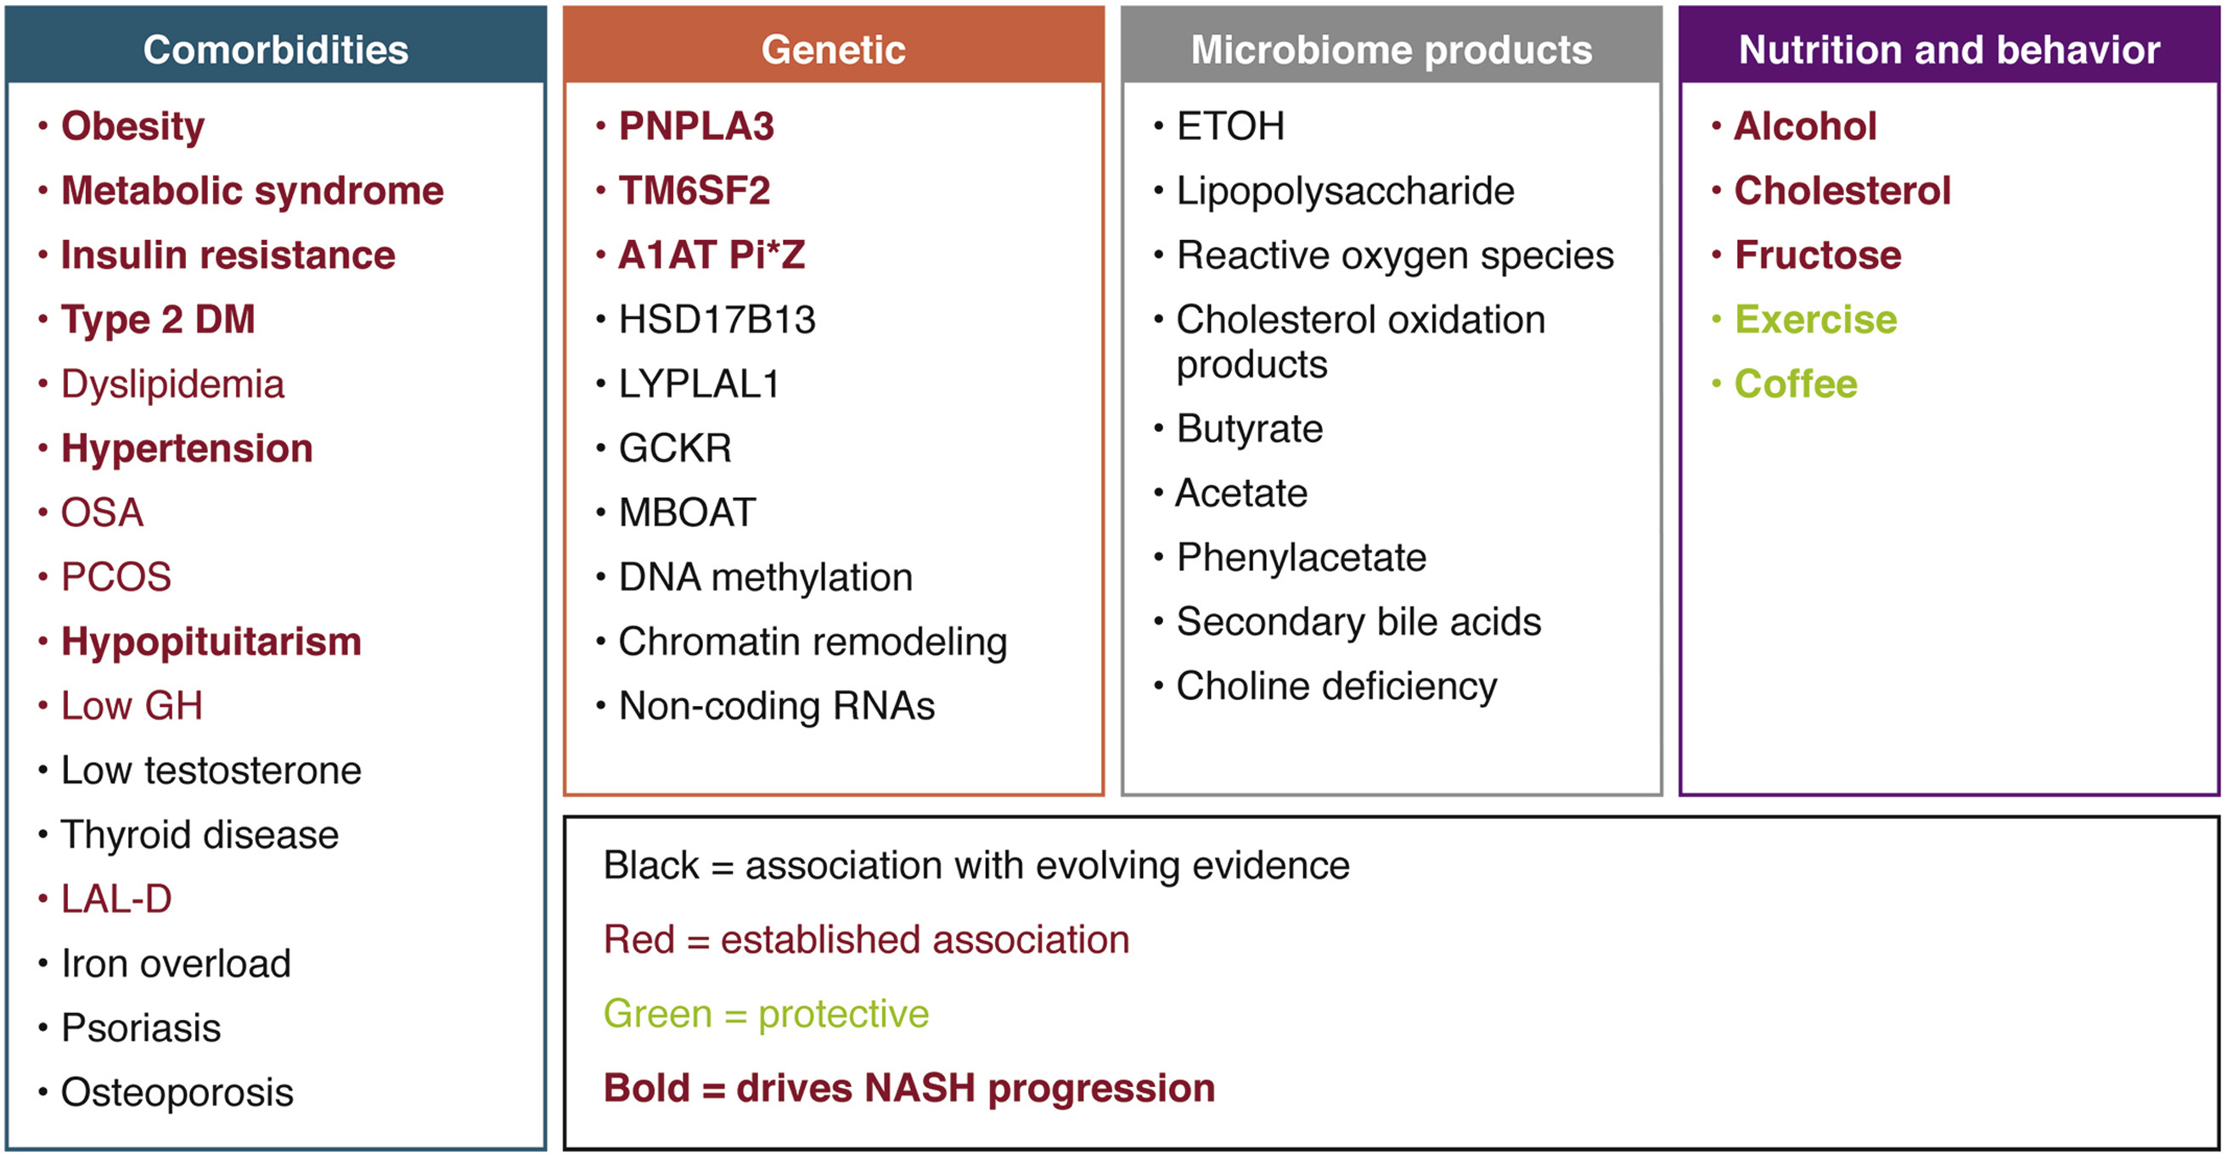
NASH: What drives progression?
Gastroenterology 2020 1581851-1864DOI: (10.1053/j.gastro.2020.01.052)

Slide 12
Important facts for all providers
NAFLD is one of most common causes of elevation of transaminases but can be normal including patients with advanced fibrosis
Liver fibrosis links with morbidity + long term survival
NAFLD and fibrosis can reverse with weight loss
Alcohol can mimic NAFLD even on liver biopsy
  Good history - > 30 g per day for M, > 20 g per day for F
  AST:ALT ratio > 2 more suggestive of alcohol

Slide 13
Who to consider screening?
BMI > 35
Type 2 diabetic > 10 years
Universal screening has not been recommended yet

Slide 14
NASH/NAFLD – Suggested evaluation

Slide 15
NASH/NAFLD – Fibrosis is the key
Assessing for fibrosis is the key tool for risk stratification
Emerging area to clarify tests + protocols for evaluation

Slide 16
Non invasive markers
Serum
APRI
FIB-4
Fibrotest
Elastography
Transient - Fibroscan
Shearwave
MR
Other
NAFLD fibrosis score

Slide 17
Non Invasive Serum Testing – FIB-4
Composite score of:
  Age
  AST
  ALT
  Platelet count
Scoring system
  < 1.45: low suspicion for advanced fibrosis/cirrhosis, High sensitivity
  1.45-3.25: indeterminant
  > 3.25: high suspicion for advanced fibrosis/cirrhosis

Slide 18
FIB4 in Type 2 diabetes
FIB4 cut offs (hepatitis C)
  > 3.25 – high suspicion for cirrhosis
  < 1.45 – low suspicion for fibrosis
Cut offs in NASH/NAFLD still being studied
FIB-4 values ≥ 2.67 were reported to be associated with 16X increase in clinical outcomes in NAFLD
Following FIB4 levels over time appear to have prognostic relevance

Slide 19
Elastography: Basic principle
Shear wave
Wave propogation
Stiffer =
higher kPa
Velocity to kPa
Lower kPa
Good negative
predictive value

Slide 20
Elastography: Key benefit
4 cm
1 cm
3 cm³
100 x larger volume than liver biopsy - less sampling variability

Slide 21
Elastography options locally (including up island)
Fibroscan
  Private pay through Percuro clinical research: $100
Shearwave elastography
  Covered at Island Health Ultrasound in almost all hospitals (not at West Coast Imaging yet)
Both are helpful to rule in and rule out significant fibrosis
Shearwave has additional benefit of conventional ultrasound with doppler

Slide 22
NASH/NAFLD – Proposed Risk Stratification

Slide 23
Components of a lifestyle approach to NAFLD/MAFLD
Energy restriction
Calorie restriction (500−1,000/day)
7−10% weight loss target
Long-term maintenance approach
Fructose intake
Avoid fructose-containing
food and drink
Daily alcohol intake
Strictly below 30 g men
and 20 g women
Coffee consumption
No liver-related limitations
Comprehensive
lifestyle approach
Macronutrient composition
Low-to-moderate fat
Moderate-to-high carbohydrate
Low-carbohydrate ketogenic diets or high protein
Physical activity
150−200 min/week moderate intensity
in 3−5 sessions
Resistance training to promote
musculoskeletal fitness and improve
metabolic factors
EASL–EASD–EASO CPG NAFLD. J Hepatol 2016;64:1388–402

Slide 24
MAFLD
Primary Care
Endocrine
Obesity/Lifestyle/RD
GI/Hepatology
Bariatric surgery
Dietician
Psychology
Fecal microbiota/FMT
Cardiology
Multidisciplinary Care Needed!

Slide 25
Summary
NAFLD/NASH and MAFLD definitions
FIB4 < 1.3 is helpful rule out test
Fibroscan/Shearwave for further risk stratification, consider if FIB4 > 1.3
Monitoring FIB4 can be helpful for assessing for progression
Multidisciplinary Care needed
GI Primary Care Pathway available - PATHWAYS

