Slide 1
Lived Experience Presentation
Abby and Leah

Slide 2
Tertiary Care for Eating Disorders

Slide 3
Disclosures
We are funded by the Division Of Family Practice to do this presentation

Slide 4
Tertiary Care in BC
1. Looking Glass Residence
2. Provincial Adult Tertiary and Specialized Eating Disorders Program at St. Paul’s Hospital
3. BC Children’s Hospital
Notes:
1 Referral Form for all 3 services
Referrals ONLY through regional eating disorders program. Patients must be followed by a primary care provider.
In lieu of no program, referral from community provider (MH/GP/Dietitian/Counsellor) - must be engaged with treatment.

Slide 5
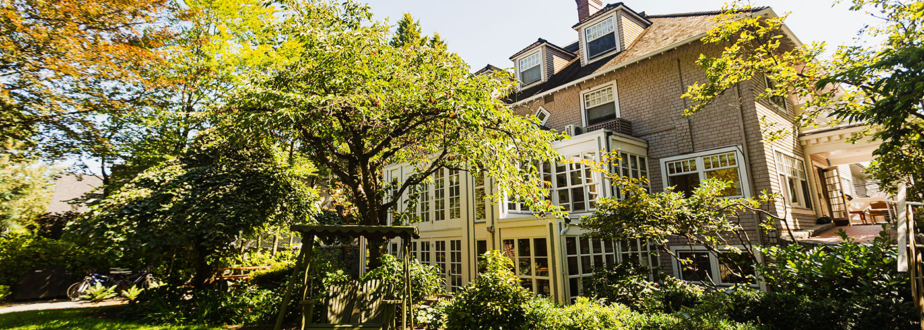
Looking Glass Residence
14-bed residential treatment facility in Vancouver, BC
Treats men and women, aged 16 to 24, suffering from anorexia, bulimia, binge-eating, and other eating disorders
24/7 care and support by a multi-disciplinary team
Minimum BMI 16.0
Voluntary

Slide 6
Provincial Adult Tertiary and Specialized Eating Disorders Program
St Paul’s Hospital in Vancouver BC
Adults aged 17
DSM V diagnosis of Anorexia Nervosa, Bulimia Nervosa or other specified feeding or eating disorder
No BMI requirement
Notes:
.

Slide 7
BC Children’s Hospital
Services have change – no inpatient eating disorders program available

Slide 8
Questions?

