Slide 1
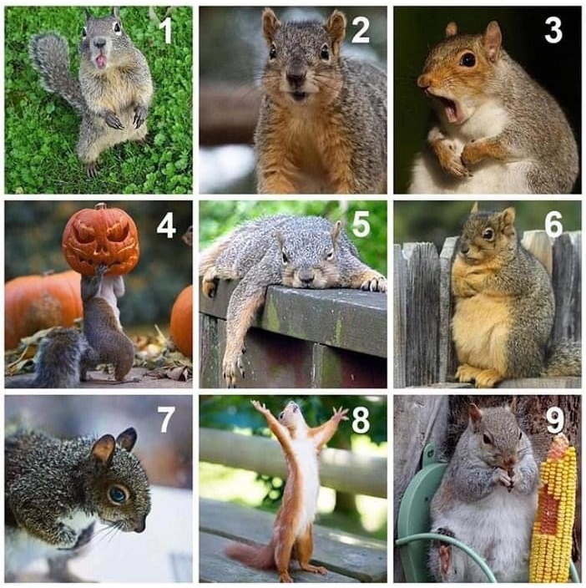
On this squirrel scale,
how do you feel today?

Slide 2
ZOOM/MEETING INSTRUCTIONS
Join via computer or Zoom app as you will be unable to vote on motions via phone alone.
We encourage you to keep your video on to connect with your colleagues.
Please keep yourself “Muted” during the presentation.
If you are making or seconding motions, please state your first and last name.
To vote – Polls will pop up on your screen. Please click the Yes or No or Abstain buttons
If you need help during the session, please click the help button and VDFP staff will try to resolve.
Questions can be submitted by using the ‘raise hand feature’ or via the chat box.
Please remember to complete the online event evaluation form. The link will be shared before the end of the program via the chat box.

Slide 3
Agenda
6:00 Online Registration
6:15 AGM business:
Meeting call to order
Approvals – 2021 agenda, 2020 minutes
Treasurer’s report: financial statements & appointment of the auditor
Confirmation of new directors
6:50 Tribute to outgoing Board members
6:55 Adjournment
7:00 Townhall Q&A with Co-chairs/board & ED
7:15 Closing

Slide 4
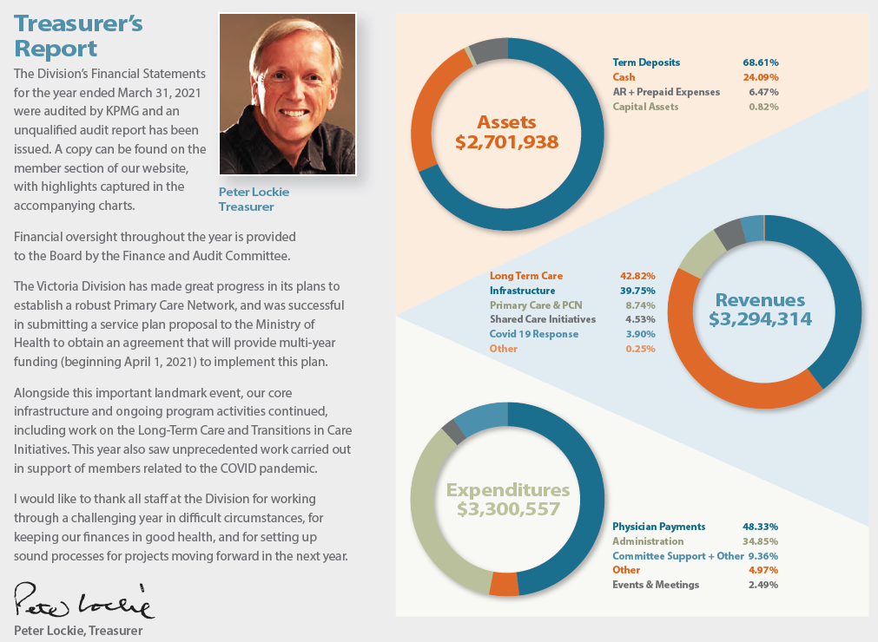
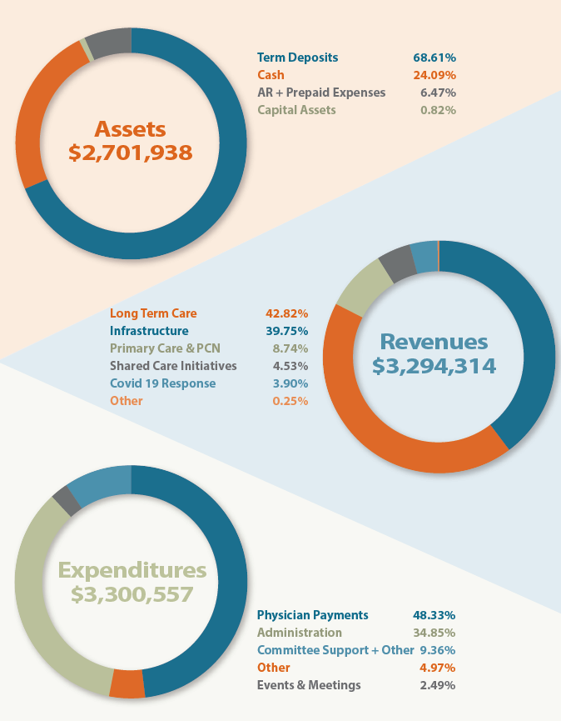
Treasurer’s Report

Slide 5
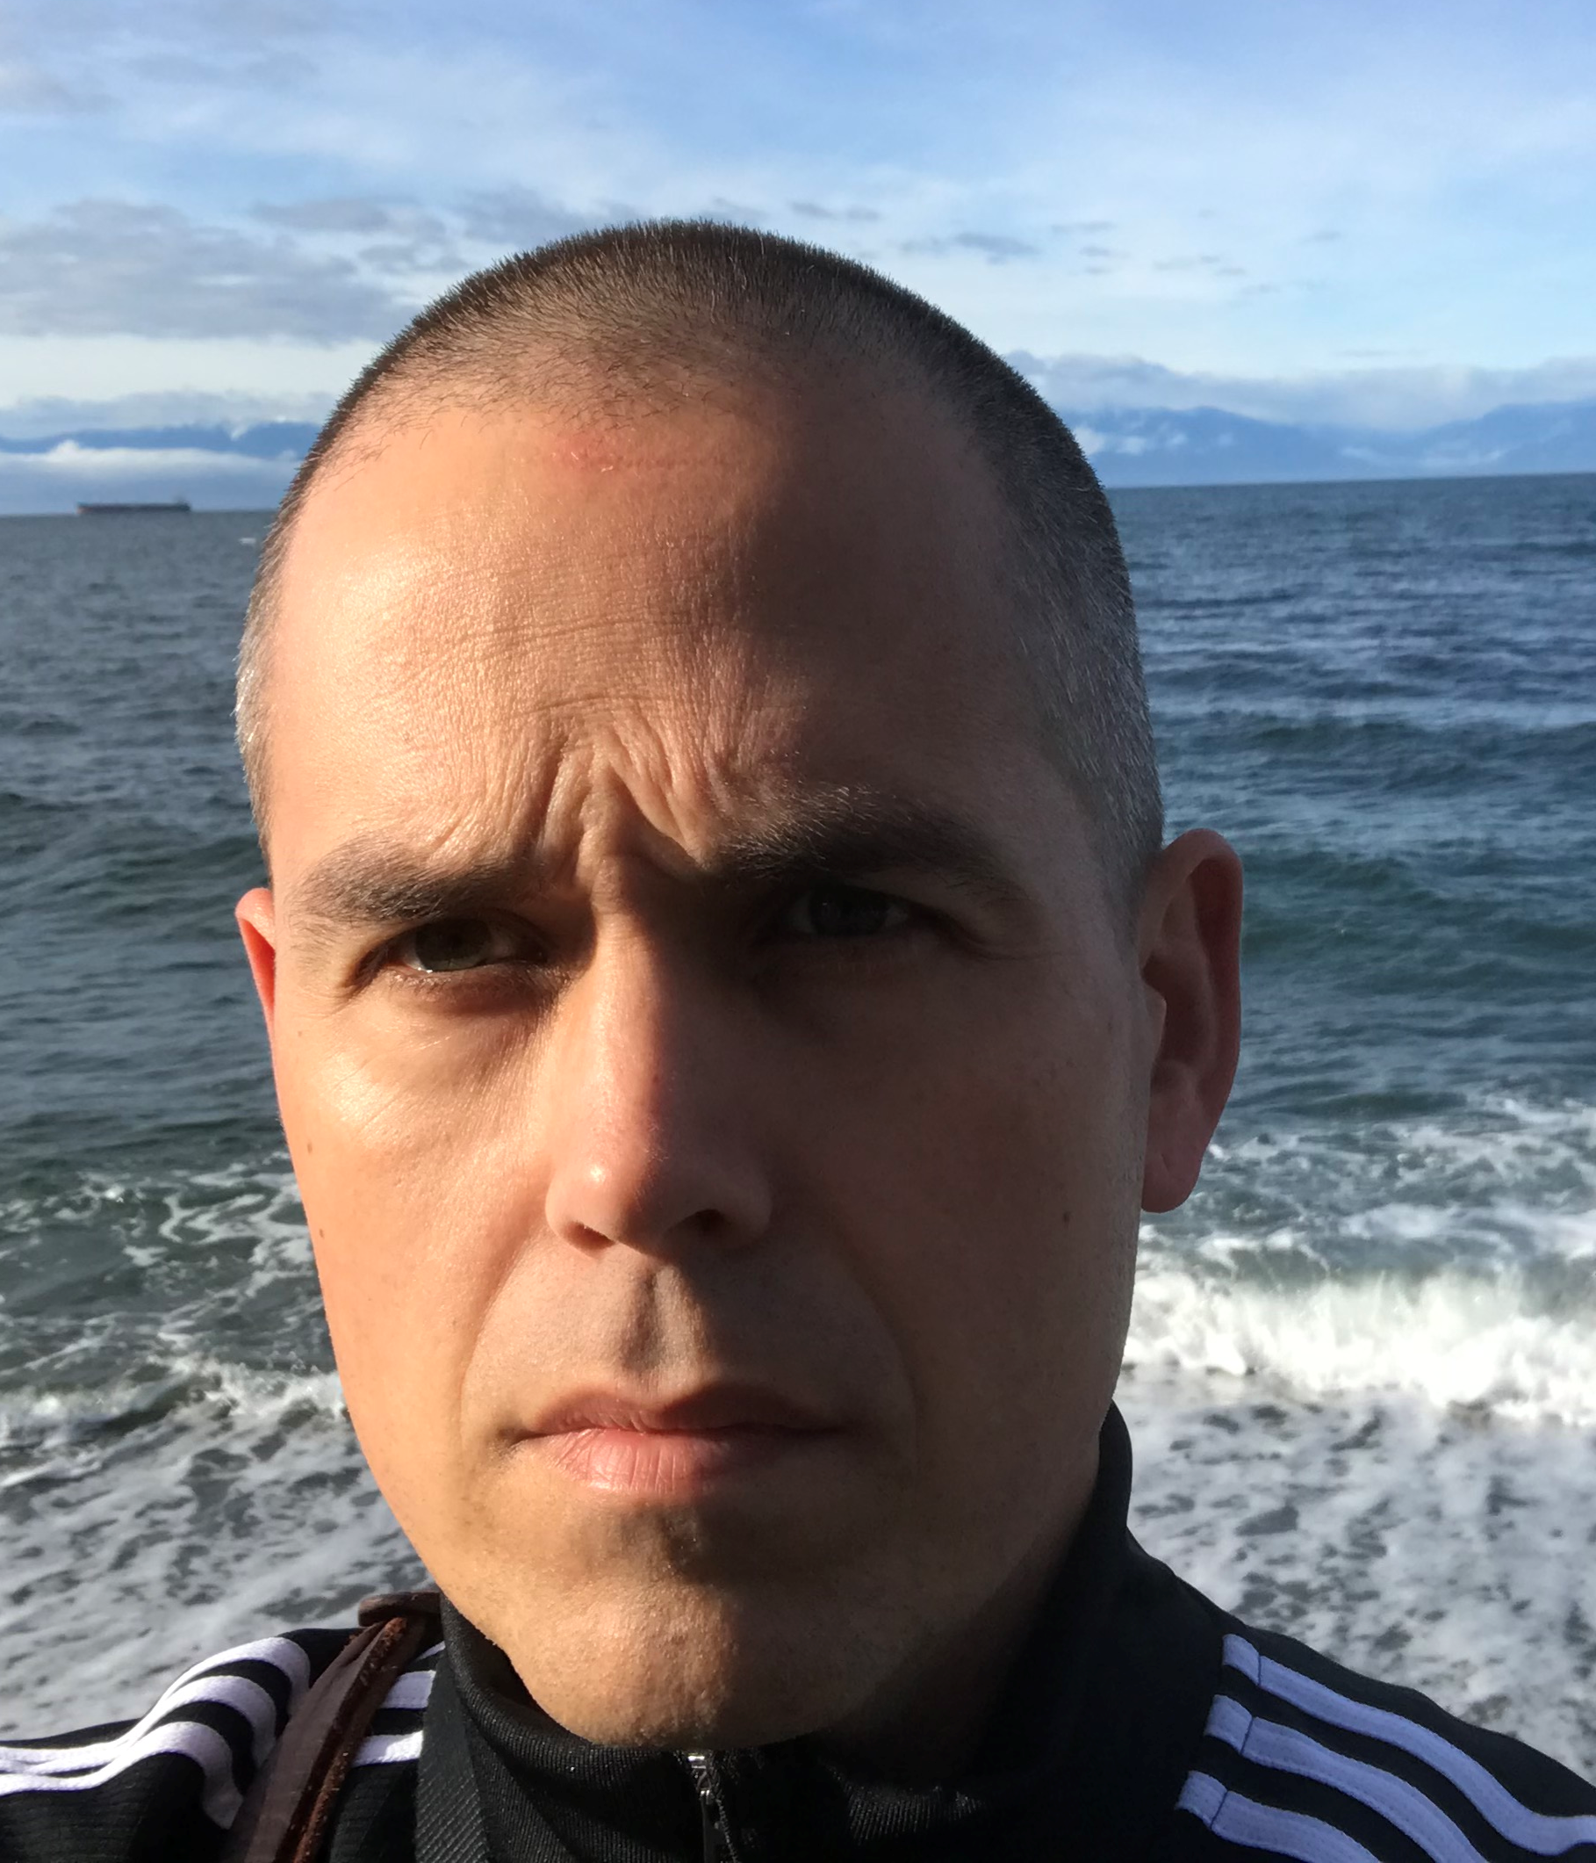
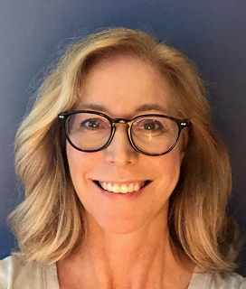
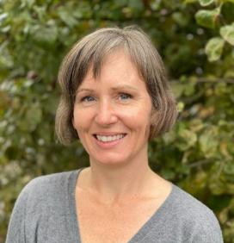
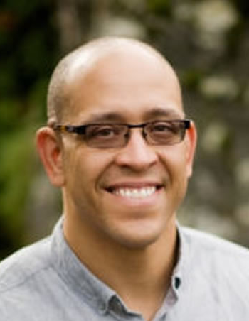
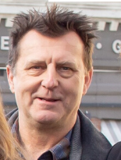
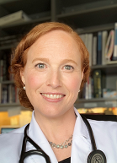
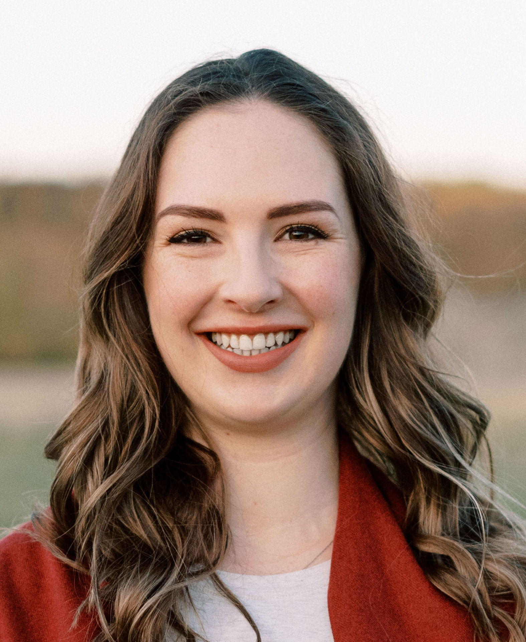
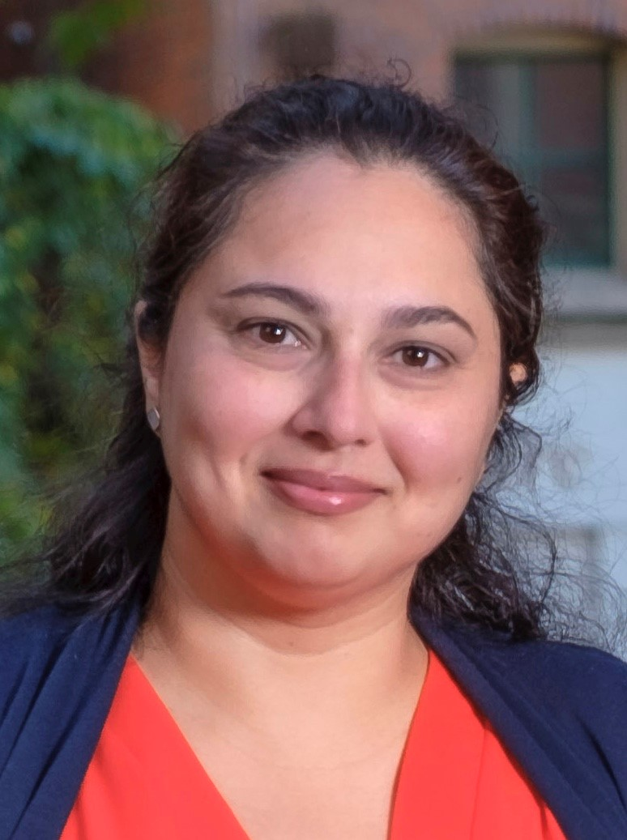
2021-22 VDFP Board of Directors
Dr. Ami Brosseau Dr. Sarah Chritchley Dr. Melissa Duff
Dr. David Harrison Dr. Geoff Inman Mr. Peter Lockie
Dr. Anna Mason Dr. Irina Simin Dr. Jessie Singh
Dr. Tim Troughton Dr. Caroline van Es

