Slide 1
Virtual Care: The ‘Do It Right The #&!$ Now’ Version
Dr. Jonathan Hislop
Email: jonathan.hislop@gmail.com
Twitter: @HislopMD

Slide 2
Overview
What is the minimum consent I need
MOA Workflow
Medeo demo
Doxy.me demo
Other choices (very briefly)
Skype, Facetime, Zoom, Livecare
Clinical Workflow
Billing

Slide 3
Patient-oriented Family Medicine in the near future today
Patient Health Concern
E-Communication
mHealth / eHealth
Asynchronous Text
Digital Tech Monitoring
Artificial Intelligence
Physical Exam Needed?
Yes
No
In Office Visit
Virtual Care Response
Follow Up Needed?
Yes
No

Slide 4
Consent
3 groups that you care about:
CPSBC
CMPA
OIPC

Slide 5
Consent: CPSBC
https://www.cpsbc.ca/files/pdf/PSG-Emailing-Patient-Information.pdf
For video consults, have some form of ‘consent’ noted in the chart.
To email clinical information to a patient, you need more express, informed consent.
Suggestion: use email for non-clinical information (practice announcements, MOA communications), and video/phone for clinical information.

Slide 6
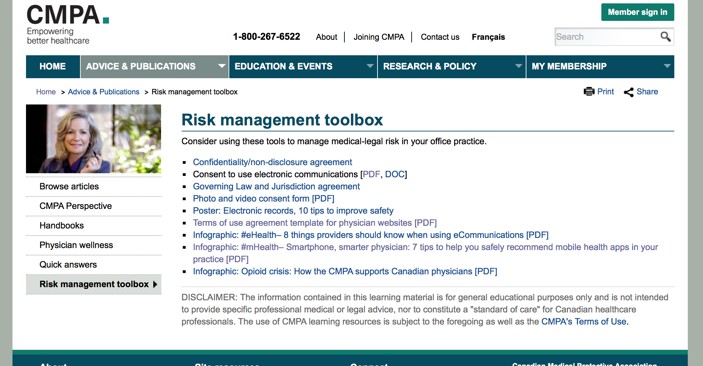
Consent: CMPA (cont’)
https://www.cmpa-acpm.ca/en/advice-publications/risk-management-toolbox

Slide 7
Privacy and Security: OIPC
OIPC: Office of the Information and Privacy Commissioner of BC
BC Physician Toolkit (BC Doctors, and Doctors Technology Office):
https://www.doctorsofbc.ca/sites/default/files/ptv3.0_full_document.pdf
The 1-page version: https://www.doctorsofbc.ca/sites/default/files/privacy_toolkit_fact_sheet.pdf
Video consult 3-page document: https://www.doctorsofbc.ca/sites/default/files/dto_health_technology_guide_-_videoconferencing_privacy_and_security.pdf.pdf
For video consults you need implied consent
Privacy:
Community physicians bound by PIPA (Personal Information Protection Act)
Health Authority/Facility physicians bound by FIPPA (Freedom of Information and Protection of Privacy Act)
Main difference: FIPPA information must be kept on Canadian servers / cannot pass through other countries.

Slide 8
Consent: OIPC
"There are two types of consent: express and implied. Patients provide “express consent” when they agree, verbally or in writing to the collection, use or disclosure of their personal information for a particular purpose. Express consent is necessary for research purposes, education purposes, or other purposes that are not related to the patient’s care. “Implied consent” on the other hand is deemed to be given
Where the purpose of collection, use, or disclosure would be considered to be obvious to a reasonable person, and where the individual voluntarily provides the information. The collection, use and disclosure of personal information for direct health care purposes in BC is usually authorized by implied consent. Implied consent can also be provided by giving a patient the opportunity to “opt-out” (e.g. when informing the patient about a referral, you provide them with a reasonable time to decline). "

Slide 9
Consent: Bottom Line
If the patient calls your MOA, and is offered a video appointment, and they agree, and they provide their email for this purpose, they have clearly provided implied consent.
Have MOA send themselves a message in the chart, or make some note that patient ‘consented to video consults’.
If you currently have no emails in your chart, and you start adding them now, consider that anyone who has their email in the chart gave consent.

Slide 10
MOA Workflow
Get Consent AND ** eMail addresses **
(Create an email list)
Inform the Practice
Use e-mail for all sorts of teaching and practice announcements
Patients phone in for appointments, and MOA tries to make it a video one
Patient to sign-in to the video platform 5 minutes prior to appointment
Recommend for the first few days, MOA calls patient to remind them to do so (like physically showing them into the room) – they will be able to stop this after a time as patients will learn
Warning – patients can actually get more impatient on video as they sometimes have no idea if they are connected properly, use emails to teach the whole practice about this

Slide 11
Virtual Care: Patient Suitability
Almost everything can actually be done by video!
Main issue will be dealing with patients who have new/worsening symptoms
In the current environment, reasonable to do everything by video first, and bring in select patients who require a physical exam

Slide 12
Demo’s
Medeo
Doxy.me
Other options:
Skype
Facetime
Livecare

Slide 13
Billing ($$)
TeleMedicine / Telehealth:
General Visit 13037 (currently $34.44)
Counselling Visit 13038 (currently $58.46)
Email/Text/Relay: 14078
Pays $7
Max 200/yr total, regardless of your practice size
Max 1/day per patient
Must provide some sort of clinical advice
No refills, appointment reminders, specialist appointment info etc
The advice must appear in the chart (within a message is adequate if that is seen in the clinical chart flow)

Slide 14
Communicating with patients: Use a Webapp
MailChimp (www.mailchimp.com)
Free if you have < 2000 people (patients)
Mailchimp 101: very short but excellent videos that tell you how to get started. https://mailchimp.com/resources/mailchimp-101/
FormSite (https://www.formsite.com/)
$50 for a form for up to 2500 people
Can be exported as a CSV file into Excel
There are certainly other options out there too

Slide 15
Clinical Workflow
Have 2 computers if you can
1 for video
1 for EMR
Start video call
Write notes as you go, create forms, prescriptions etc
Send tasks to MOA to fax forms, prescriptions etc
Both Medeo and Doxy.me (paid version) allow you to transfer files/PDFs to the patient if you are able to get them out of the chart. Be sure to delete them off your computer!

Slide 16
You can do this!!!

