Slide 1
Polypharmacy Risk Reduction in the Context of Complexity, Frailty and End of Life
TORCH Education Program
Victoria, BC
Feb 14, 2015
Dr. Chris Rauscher

Slide 3
Objectives/Focus
Understand the basics of Polypharmacy Risk Reduction (PRR)-What, Why
Understand moving from a focus on decisions about medications in general to making clinical decisions in the context of resident complexity, frailty and end of life as an intro to today’s session
Disclaimer- no conflicts of interest, although I am getting paid to be here as the Clinical Lead for the Shared Care PPh initiative

Slide 4
What Exactly is Polypharmacy?

Slide 5
What exactly is polypharmacy?
If not defined by number of medications, then:
Clinically indicated: proven benefit or benefit>harm
(Clinically) Warranted- Justification for an action or a belief → Bring in patient/resident/family perspective
Polypharmacy Risk Reduction
  More than looking at individual drugs or drug classes-Balance
  More than stopping meds
  Starting meds
  Reducing dose
What is ‘appropriate’ for this resident?

Slide 6
Why is Polypharmacy Important?

Slide 7
There is No Magic Number To Define Polypharmacy But Adverse Events Increase as Meds Increase
Likelihood of an ADE
2 pills.........................................13%
5 pills.........................................58%
7 or more………………………………………………..82%

Slide 8
Adverse Drug Events
‘Events’: Falls, Delirium
Side effects (Versus ‘Drug Reactions’)
Interactions
  Drug-Drug
  Drug-Disease
  Drug-Nutrition

Slide 9
Adverse Drug Events
(ADE’s)
  Acute care Admissions
    Elderly - 16% of all admissions (27-40% preventable)
    Younger- 4% of admissions (20% preventable)
    J Am Geriatr Soc. 2002 Dec;50(12):1962-8. BMJ 2004 Jul 3;329(7456):15-9 ; JAMA 1998 Apr 15;279(15):1200-5. ; Pharm World Sci. 2002 Apr;24(2):46-54.
  Residential Care
    10% of LTC population/month have ADE
    (Gurwitz:Am J Med. 2005 Mar;118(3):251-8.)
    40% preventable

Slide 10
Common Side Effects For Meds
Fatigue, weakness, muscle aches
Anorexia, nausea, bloating, cramps, constipation, diarrhea
Dizziness, postural instability, orthostatic hypotension , hypoglycemia
Confusion, sedation, headaches, insomnia, restlessness, agitation, delirium
Decreased general health
Increased risk of falls and hip fracture
Decreased cognitive function

Slide 11
My belief: Accumulation of minor side effects = people could feel crappy!
Affecting their function and quality of life!

Slide 12
Polypharmacy is a stand-alone risk factor for morbidity and mortality
Even when we control for other comorbidities and specific drug effects.

Slide 13

Hospitalisation-Associated Disability
Hospitalization is a sentinel event that often precipitates disability. This results in the subsequent inability to live independently and complete basic activities of daily living (ADLs). This hospitalization-associated disability occurs in approximately one-third of patients older than 70 years of age and may be triggered even when the illness that necessitated the hospitalization is successfully treated.
13

Slide 14
The Challenge
Average number of regular medications per LTC resident in BC is around 9 (range 0-55!). Anecdotally, 12-14 not uncommon.
With careful practice, this number can be 5-6
RAI-MDS counts number of residents on >9 regular meds, and this is often above 50%
What is your site’s RAI-MDS data?

Slide 15
What are the Causal Factors
Leading to Polypharmacy?

Slide 16
What are the causal factors leading to Polypharmacy?
Wrong Context: Single Disease-Shift to Complex, Multimorbidity, Frailty, End of Life
  Clinical Practice Guidelines (Chronic Disease Management)
  Multiple prescribers
  Treating surrogate markers
  Clinical uncertainty
    ADE or new symptom?-Drug cascade
  Uncertain treatment goals
Notes:
Involve all members of the “Circle of Care” from the get-go
Raises awareness, facilitates buy-in, prevents moral distress
Respect people’s time and contributions
Create review schedule in advance so team can be prepared with the correct information

Slide 17
What are the causal factors leading to Polypharmacy?
Clinical and system complexity
  Difficulty getting the history
  Inadequate communication
  Collaborative and Shared Care challenges
  Challenges of involving resident/family

Slide 18
What are the barriers to effective Medication Decision-Making?
Notes:
Involve all members of the “Circle of Care” from the get-go
Raises awareness, facilitates buy-in, prevents moral distress
Respect people’s time and contributions
Create review schedule in advance so team can be prepared with the correct information

Slide 19
What are the Barriers to Effective Medication Decision-Making?
Consensus on clinical/pharmacological knowledge, especially with complexity of resident population
Perceived Medico-legal Risks
Process and communication issues
Absentee MRPs
Other care priorities, time, remuneration.
Family and Resident Involvement

Slide 20
Supportive Initiatives:
TORCH
GPSC Res Care
Physicians Data Collaborative
CIHI Data Project
Tools-ADAPT, Med Stopper.
Community
Professional Academic Detailing in GP offices - Medication knowledge
Polypharmacy RR - Medication review
Transition in Care
Transition in Care
Patient
Residential Care
MedRec - Best possible medication history
CLeAR - Appropriate antipsychotic use
Polypharmacy RR - Medication review
Hospital
MedRec - Best possible medication
history
48/6 - Assess 6 areas w/in 48 hr
Polypharmacy RR - Medication review
Transition in Care

Slide 21
What Will Help You To Make Effective Decisions About Medications?
Notes:
Involve all members of the “Circle of Care” from the get-go
Raises awareness, facilitates buy-in, prevents moral distress
Respect people’s time and contributions
Create review schedule in advance so team can be prepared with the correct information

Slide 22
Evidence-Based Approach
Notes:
Involve all members of the “Circle of Care” from the get-go
Raises awareness, facilitates buy-in, prevents moral distress
Respect people’s time and contributions
Create review schedule in advance so team can be prepared with the correct information

Slide 23
What about in Residential Care ?
Garfinkel, Zur-Gil, Ben-Israel; IMAJ (Vol 9), June 2007
190 patients in 6 geriatric nursing departments on 7.09 regular meds/pt.
119 pts; after careful review, 2.8 regular meds/pt stopped (4.3 meds/pt)
71 pts in control group on same wards with same doctors, with meds unchanged, studied for one year.

Slide 24
Results
No significant adverse events
1 in 10 drugs eventually needed to be restarted
One year mortality rate was 45% in controls and 21% in the study group (P<0.001)
Annual referral rate to acute care was 30% in controls and 11.8% in the study group (P<0.002)

Slide 25
Evidence-Based Approach and Tools
Notes:
Involve all members of the “Circle of Care” from the get-go
Raises awareness, facilitates buy-in, prevents moral distress
Respect people’s time and contributions
Create review schedule in advance so team can be prepared with the correct information

Slide 26
What Approaches/Tools
Beers Criteria; STOPP/START: Mix of specific drug/drug classes of concern plus specific drug interactions
  Too many variables to remember/work with unless have an electronic system
Our approach- Specific drug/drug classes of concern

Slide 27
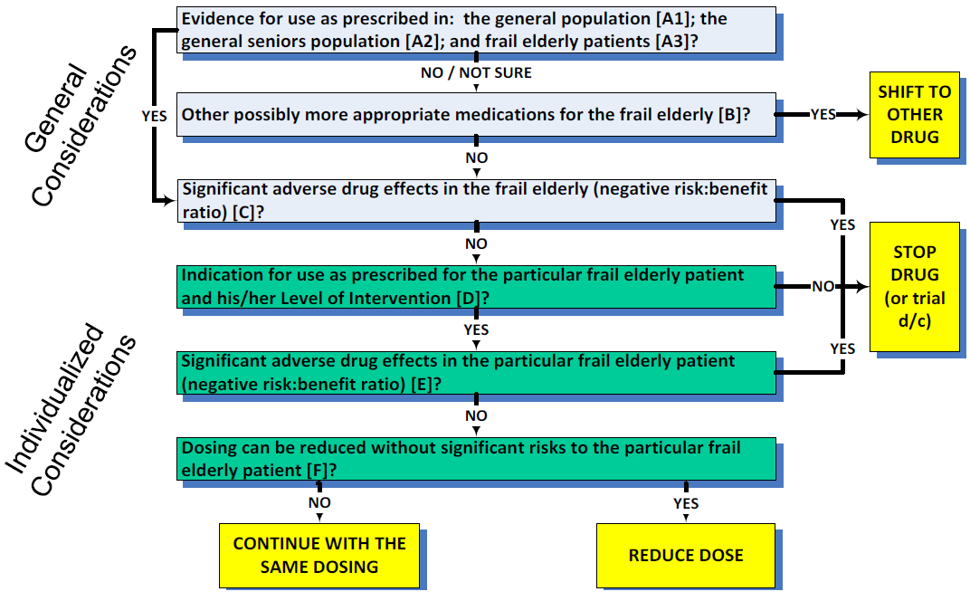
Drug Decision Algorithm
Adapts Garfinkel (2010) – evidence, risks, indications, etc.

Slide 28
Priority De- Prescribing Drug List: Lower Doses, Trial Discontinuation
Drugs associated with
  Confusional States
    antipsychotics, antidepressants, opioid analgesics, hypnotics, digoxin
  Adverse Drug Event-related Falls
    antipsychotics, antidepressants (tricyclics), hypnotics, antihypertensives, hypoglycemics, anticonvulsants, antiparkinson meds, antihistamines
  Significant Anticholinergic Effects
    antidepressants (tricyclics), antihistamines, bladder meds
  Bleeding
    warfarin, antiplatelet meds

Slide 29
Priority De- Prescribing Drug List: Lower Doses, Trial Discontinuation
  Indications no longer present-Symptom Control
    PPIs, analgesics, antianginals, antipsychotics, antidepressants
  Indications not present-Preventative
    Statins, osteoporosis meds, antihypertensives

Slide 30
Supports For Drug Review Decisions
Guide individualized consideration of patient-at-hand
  Drug Advisory Sheets [drafts] + One-page: “You Decide”**
    PPIs ANTIPSYCHOTICS STATINS HYPNOTICS ANTIHYPERTENSIVES ANTIDEPRESSANTS BISPHOSPHONATES VITAMIN D & CALCIUM SUPPLEMENTS
  Drug Brief: Calcium
Understanding of clinical condition
  Condition Advisory Sheets
    STROKE PREVENTION IN THE ELDERLY (DRAFT)
    DEPRESSION IN THE ELDERLY (DRAFT)
    TREATING DIABETES IN THE FRAIL ELDERLY (FORTHCOMING)
Materials are aligned with GPAC and OPUS materials – and will be reviewed by a Clinical Advisory Team

Slide 31
What Statistical Tools Will Help With With Clinical Decision-Making?
Notes:
Involve all members of the “Circle of Care” from the get-go
Raises awareness, facilitates buy-in, prevents moral distress
Respect people’s time and contributions
Create review schedule in advance so team can be prepared with the correct information

Slide 32
Stats
Distinguish by drugs for symptom control versus drugs for preventing a future event
Event rates- The proportion of patients in a group in whom the event is observed
NOT Relative Risk Reduction- Used to compare the risk of an event happening in two different groups of people
Absolute Risk Reduction- Risk of developing an event over a time period
Number Needed To Treat (NNT)/Number Needed To Harm (NNH)

Slide 33
Stats
Time to Benefit (TTB)/Time to Harm (TTH)
Time to Lose Benefit (TLB)/Time to Reduce Harm (TRH)
Statistical benefit vs clinical benefit (harm)

Slide 34
Number Needed To Treat-NNT www.thennt.com
Estimating the number of patients that need to be treated in order to have an impact on one person.
The concept is statistical, but intuitive, for we know that not everyone is helped by a medicine or intervention — some benefit, some are harmed, and some are unaffected. The NNT tells us how many of each.

Slide 35
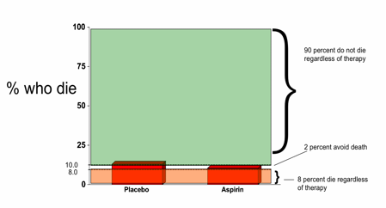
Deaths reduced 10% to 8%= 2% Absolute Risk Reduction
RRT (relative risk reduction)= 2%/10%=20%
NNT= 1/ARR=1/2=100/2=50=Treat 50, avoid 1 death
NNH-2% Additional Bleeds, Treat 50, 1 bleeds

Slide 36
Statins- Before ‘You Decide’
Discontinue if for primary prevention; if for secondary prevention, apply risk-benefit analysis and continue treatment only for demonstrated significant vascular risk: past MI/stroke

Slide 37
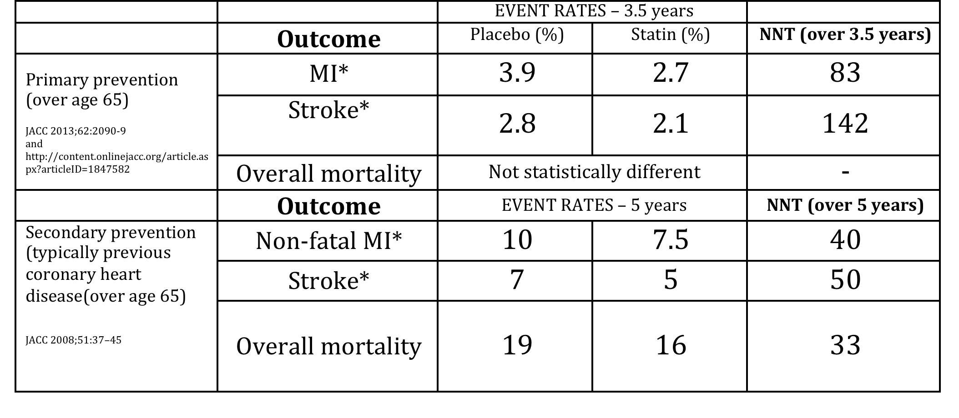

Slide 38
Statins- ‘You Decide’
Harms- Major Uncommon:
  Asymptomatic liver enzyme elevations by 0.4%; Rhabdomyalysis: ?
  Risk of type2 diabetes by 0.5%, in ‘pre-disposed’, < CV risk in many people
  Memory loss/’confusion’-?
Harms- ‘Minor’ side effects
  Muscle-related symptoms-10-50%?, residents cumulative causes aches and pains
  Nausea, gas, diarrhea or constipation

Slide 39
Statins- ‘You Decide’
Review the use of a statin in the residential care environment in the context of life expectancy and goals of care, as well as from the perspective of the potential aggregation of adverse effects from multiple meds that may affect mobility/function and quality of life. Is the benefit greater than the potential harm?

Slide 40
PPIs- You Decide
Symptomatic control- Stats not as helpful: PPIs somewhat more effective than H2RA
Many patients are on long term PPIs without clear ongoing indication/benefit, and the more drugs, the more potential for side effects/adverse events and time taken to administer:
  For GERD- Use 4-8 weeks then trial discontinuation
  May have been started for ‘stress ulcers’ in hospital but can stop when discharged, unless major ongoing bleeding risk

Slide 41
Moving From Focus on Single Drugs/Drug Classes to
Whole Drug Profile
In Complex Residents
Notes:
Involve all members of the “Circle of Care” from the get-go
Raises awareness, facilitates buy-in, prevents moral distress
Respect people’s time and contributions
Create review schedule in advance so team can be prepared with the correct information

Slide 42
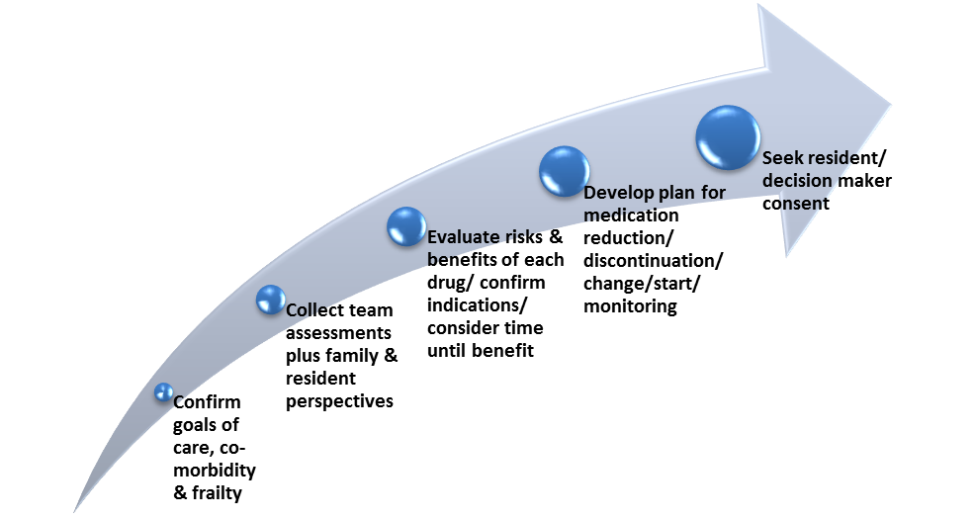
Fraser Health Guide To Person-Centered Medication Decisions

Slide 43
Starts with your own goals (beliefs, values)- for meds:
  only those ‘warranted’, quality of life (active symptoms), function
  Management- Not always or only with meds: non-pharmacologic approaches- pain, constipation, mild depression, BPSD etc.

Slide 44
Utilize Comprehensive Geriatric Assessment and (Repeatedly) Communicate Prognosis with patients families and community workers

Slide 45
Estimate Remaining Lifespan- Life-limiting conditions
  Interested in prognosis, trajectory of decline to set context for goals of care and decision-making
  In most will be dementia as an end of life condition (Dr. Rosenberg: ‘Palliation for Advanced Dementia’
  In some may (also) be chronic-exacerbating conditions- CHF, COPD, neurologic-Parkinson’s, MS etc.
‘Surprise question’- ‘would you be surprised if this person is still alive in 6 months’: Frailty, triggers-reduced nutritional intake, febrile illness, pneumonia, repeat ‘exacerbations’, progressive CRF, low BP, low Na

Slide 46
Use of Medications of Questionable Benefit in Advanced Dementia
Tjia et al JAMA Int. Medicine Sep. 8th 2014
N= 5406 nursing home residents with advanced dementia (MMSE-5)
54% were on medications with questionable benefit
  22.4% statin drugs
  Lower likelihood
    Not having an Eating problem
    DNR
    Enrollment in Hospice
35% of all medication expenditures were for medications of questionable benefit
  Cost $553/$816/90 days

Slide 47
Determine what impacts quality of life and function
  This will usually be the main focus of the care plan
  May be ‘hidden’ and require Tx (not always or only with drugs)- pain, constipation, depression
  BPSD with Dementia (http://www.bcbpsd.ca)
  Current
  Potential
    Exacerbating conditions, neurologic-Parkinson’s, etc.
  Broader- Emotional, social, activities

Slide 48
Goals of Care
With that background/context, apply a ‘goals of care’ approach: Drs. Christine Jones and Ted Rosenberg
Document conversation in the following categories:
Function improvement/maintenance
Symptom reduction
Place of care
Caregiver burden
Transfer to acute care
Wishes for survival (long as possible, or not, CPR, Antibiotics, etc)

Slide 49
Goals of Care
Get direction on medication use from the goals of care discussion
  Survival
  Qof L and Function and Symptom control
  Transfer to acute care- Tx in facility, coming back on more meds
Trade-offs- benefit versus harm-particularly important for medications discussions/decisions

Slide 50
Medication Decision-Making in Complex Health Situations
No direction from the literature as ‘multi-morbidity’ is a new area of study-SO Let’s discuss with the cases and analyze how we are making those decisions
Starts with medication reconciliation identifying ‘indication’ for each medication
For med review-Can go medication by medication but more likely to be ‘on balance’ thinking within the context of lifespan/prognosis/goals of care
Be aware of changing drug tolerability with aging/frailty

Slide 51
Medication Decision-Making in Complex Health Situations
Often start with the drugs used to ‘prevent’ a future event, incorporating the individual risk of having such an event (primary versus recent secondary): Time to Benefit/Harm
Be more careful with drugs for ‘exacerbating’ conditions (CHF, COPD) and neurologic control

Slide 52
Care Planning
Set the medication plan into the overall care plan-Collaborative care
Tapering and monitoring with review are important to specifically include-involving staff (care aids), family (resident directly or by observation)

Slide 53

Goals of Care
His Goals (82 y.o. commmercial pilot; Dr. Rosenberg)
    Symptom Control
      Less dopey
      Stronger - sit up longer and read paper, talk with family
      -Less Dizzy
      alleviate pain in legs and back
      Improve Appetite
      Relieve constipation
      Nocturia hourly
      -relieve uncomfortable edema.
    Function
      ADL-Alleviate Tremor – can feed self and brush teeth/AM Care; get out of diapers
      Social: Stay up long enough to visit with Daughter without severe fatigue
      not be so dependent on wife

Slide 54
Goals of Care
    Medical Interventions:
      No CPR, Not go to hospital, No tubes etc….
      Doesn’t want to go out for medical appointments
      Blood tests OK if done at home.
      Antibiotics OK if I will feel better
    Survival / Residence - Die at home – “I am ready to go”,
    Caregiver Burden- Reduce Strain on his wife
  Wife’s Goals
    Delay his death as long as possible
    Improve his comfort
    Care for him at home

Slide 55
GOC Outcomes- Symptoms, Function Health Care CG burden
Goals | Agents | Actions | Impact of Change/Goal
Fatigue/Dopey/weak | Hypotension Sedation | Taper off zoplicone Taper off dilantin Taper off all BP pills/nitrodur Stop Zoladex/bicalut. Treat Thyrotoxicosis | Sleep OK Can stay up 3 hours Ramipril 5mg od FU BP 142
Less Dizzy | BP Psychoactive meds | “ “ | Gone
Back and Leg Pain | Statin Sertraline RLS? Chair and Bed | Stop Statin Stop Sertraline Add Reg TES PT- ROHO Cushion | Leg Pain gone Back pain manageable
Anorexia Constipation Edema and Nocturia | Meds Hydration Meds | Stop OTC, ca Iron, ASA, Alend , etc Dietician Stop amlod. + lasix | Enjoys food again Edema +1 Nocturia x2
Social : visit with family Read Paper ADL: Feed Self, A.m. Care Get out of pads Not be dependant on wife | ^{Tremor} ^{Fatigue} | “ “ Taper off Sertraline Rx Thyrotoxicosis tapazole | Can eat with left hand, brush teeth Visits with Daughter in PM, reads paper Still in pads GDS 0, sleep better
Health Care burden- Care giver burden | Multiple specialists | Call and cancel appt Lab in Home Health Care Directive | Wife and him more relaxed Home supports TID

Slide 56
You will really know when…
78 y.o. married man, 7 children, mild Alzheimer dementia, 2 strokes in one month, hospital multiple complications, comfort care/no meds, to res care
The neurologic “As’-apraxia, agnosia, aphasia
Psychotic-danger to self and others, distress→ antipsychotic, Trazodone
Physically strong-live ‘years’
Family don’t want other meds (mild hyperglycemia and hypertension), care in facility only
The decision-making journey…

Slide 57
Follow-up
Dr. Chris Rauscher: rauscherchris50@gmail.com, 604-908-2461
http://www.sharedcarebc.ca/initiatives/polypharmacy/Clinical%20Support

