Slide 1
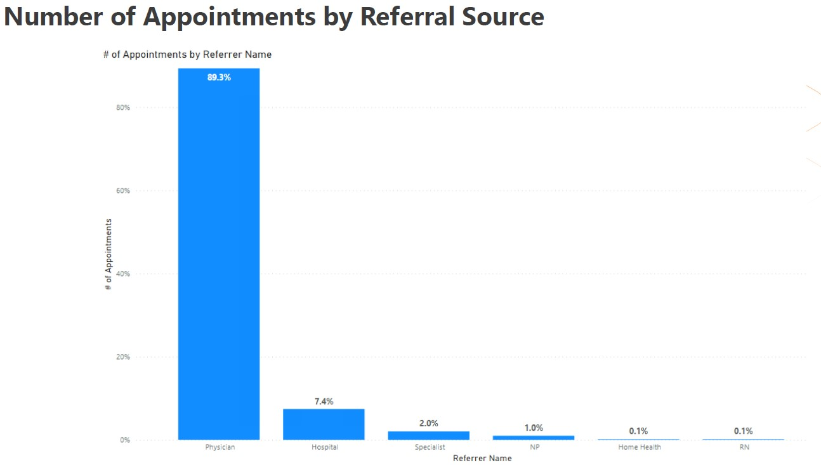
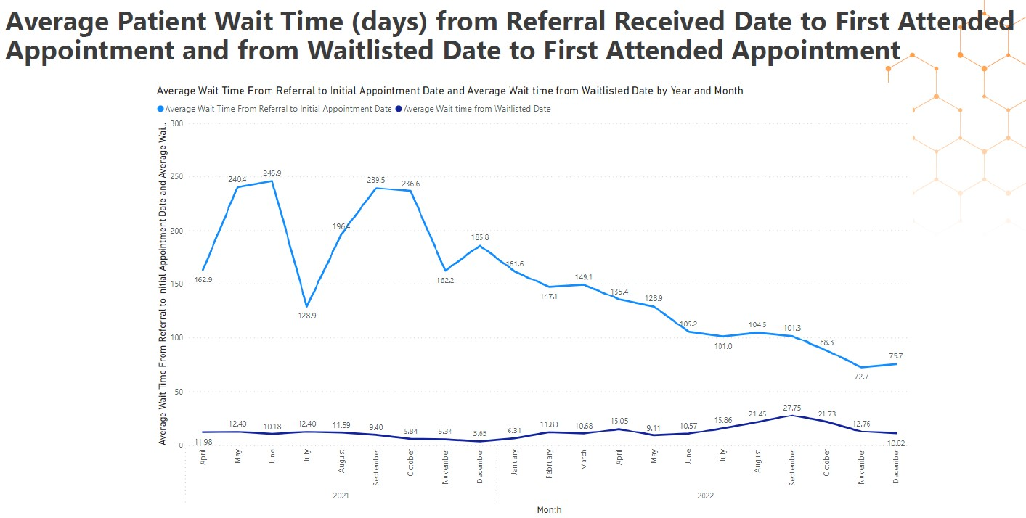
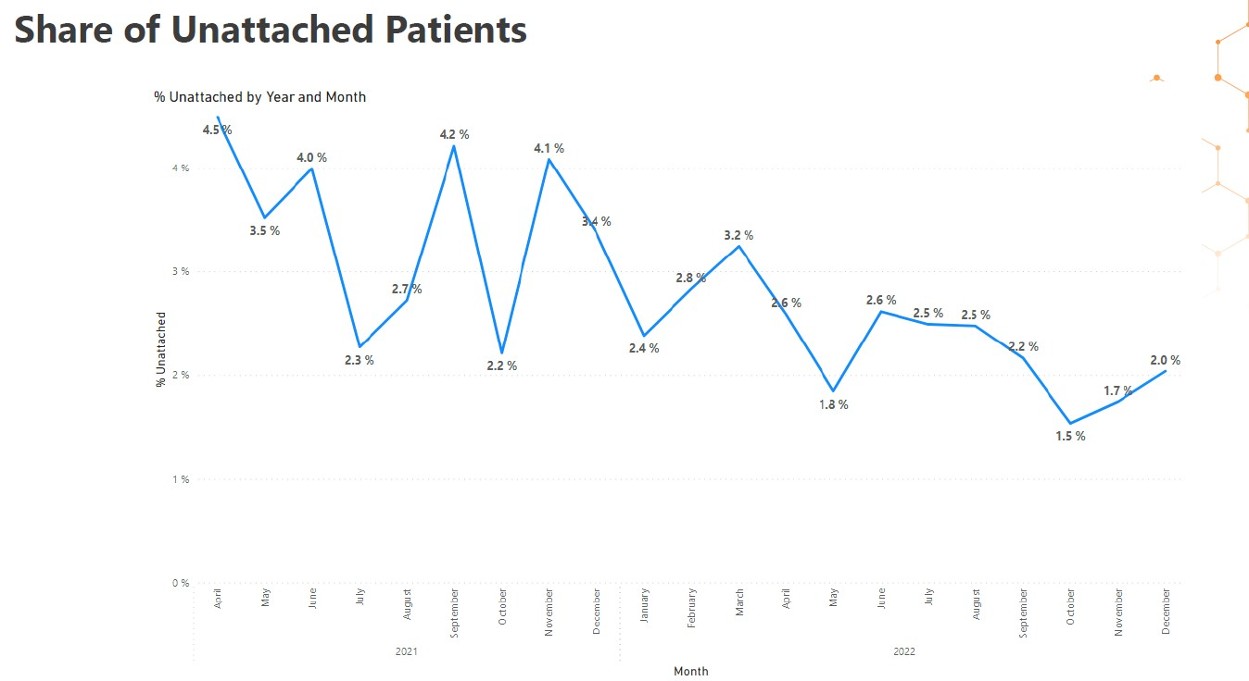
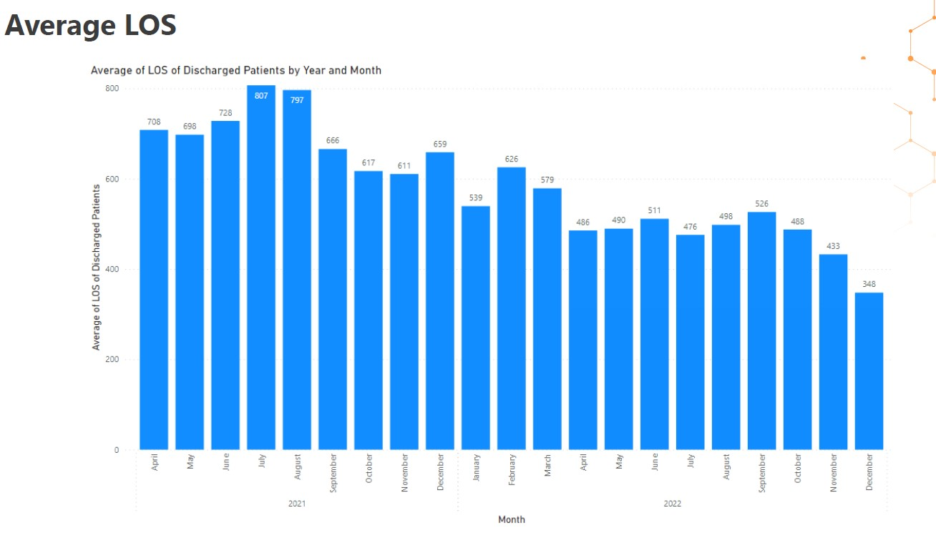
Family Physicians and Fraser Health: Co-Developing a Dashboard to Gather Critical Seniors Clinic Care Data
About the Coordinating Complex Care for Older Adults (CCCOA) Project
Facilitator of Success: Alignment of Goals
Improve communication and collaboration as a multi-disciplinary care team as seniors transition through various providers and parts of health system.
Support seniors to stay at home as long as possible by connecting with home health and community supports.
Timely access for patients (reducing wait times)
Started with an average wait time of 18 months and goal is to 2-3 months
Reduce length of stay (LOS) in clinic to enhance capacity for new patients
Improve quality of referrals received into SSC to reduce wasted time
Improve communication between SSC and GPs
Surrey-North Delta CCCOA Project Goals
Specialized Seniors Clinic Goals
The Surrey-North Delta Coordinating Complex Care for Older Adults project was funded by Shared Care. One focus area of the project was collaboration with the Specialized Seniors Clinic (SSC) located in the Jim Pattison Out-Patient Care & Surgery Centre in Surrey, BC, and run by Fraser Health. It had two main goals (see Venn diagram to the right ->)
As part of this collaboration, the project conducted a family physician survey and SSC workflow mapping, which resulted in:
Referral and in-clinic flow maps
Updated referral form for FPs
Support from Division of Family Practice to attach unattached patients
Improvements in hospitalist referrals
Need for metrics to assist measuring success/ impact of changes
Image: Surrey-North Delta Division of Family Practice
Project Timeline: Developing Metrics to Measure Impact of Changes
Feb – Mar. 2022: Patient journey mapping
4-part patient journey mapping exercise with FP members of the WG and key stakeholders from the SSC. The patient journey mapping exercise followed the start-to-finish communication process between family physicians, patient, and the SSC. This allowed for thorough understanding of where the communication gaps in the patient journey are and why they were occurring.
May 2022: Project meeting
Presentation was given to the full Seniors Clinic interdisciplinary team on May 11 to gain buy-in and approval to proceed with the proposed next steps. The Seniors Clinic agreed to the importance of the creation of a Complex Care Interdisciplinary Rounds Toolkit as well as the creation of a Key Performance Indicator (KPI) dashboard help align project goals + outcomes.
October 2022: First Draft of Data
In October, the team was notified that the data had been retrieved, and a first draft of the indicator report had been put together. ALL TWELVE indicators were able to be included in the report, which exceeded the team’s expectations.
Jan. – Mar. 2022
Apr. – Jun. 2022
Jul. – Sep. 2022
Oct. – Dec. 2022
Jan. – Mar. 2023
Thematic Analysis
The identification of “key themes” were revealed in the areas of: New Learnings, Unanswered questions, Opportunities for Improvement, and Data Collection & Validation.
June 2022: Indicator list created
Key performance indicators developed and confirmed with working group. A list of 12 indicators was submitted to Fraser Health, with the hope of receiving data for 2-3 indicators.
March 2023:
After some smaller presentations and refinements, a full presentation of the data was shared with the Working Group by the team at Fraser Health. Final edits are being made to the data set before it can be shared directly with the working group and rolled out to Seniors Clinics regionally.
List of Key Performance Indicators
Sample Data
Next Steps
Question | Indicator(s)
Has there been an improvement in the quality of referrals to the SSC? | # rejected/returned referrals by month % rejected referrals out of total referrals/month (by provider type)
Has the wait-time to access the SSC decreased? | Length of time from referral to first visit Wait time by urgency of referral (emergent, urgent, routine)
Has the length of stay at the SSC decreased, to enable more patients to access the program? | Average length of stay in program: time from first visit to discharge from program Total number of patients seen at SSC, by year
Have attached patients referred to SSC been attached to a primary care provider? | # of unattached patients referred to SSC #/% of unattached at referral who are attached by discharge
What is the volume of patients seen at the SSC? | # first visits per month # unique patients seen per month (% also seen by Home Health) # visits per month
Has there been a decrease in the no-show rate? | % “no-show” appointments (by provider type)
Now that this KPI Dashboard has been produced, it is intended to be populated on a regular basis for all Seniors Clinics in the region. This will be used to support quality improvement, communication, and coordination of care between seniors clinics and primary care providers.
Acknowledgements
Thank you to the CCCOA Shared Care Project Working Group: Dr. Mark Blinkhorn, Dr. Marie DiCesare, Dr. Sharmila Yang, Laurie Chiesa, Kimberly Choi, as well as Dr. Karanvir Sall, Ashifa Ahmed and Moria Fromager from the SSC and April Bonise (Project Lead) for their involvement in this work.

