Slide 1
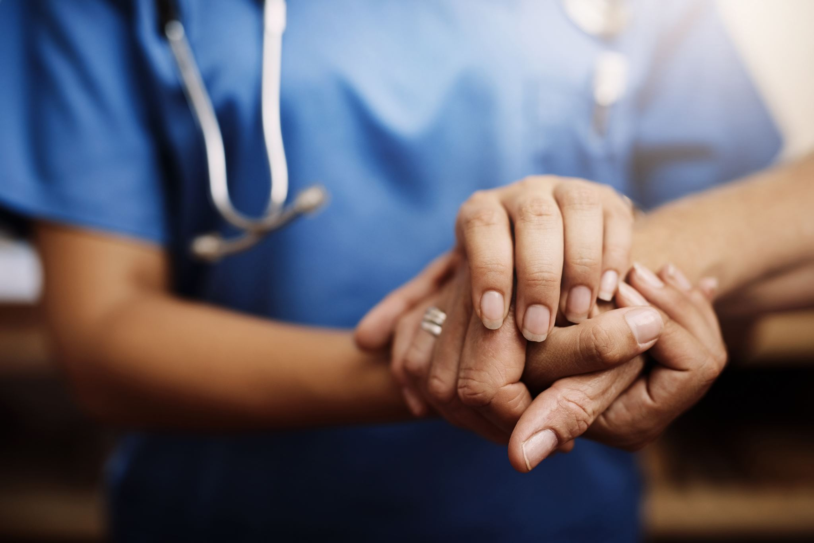
The 4 Cs of Emergency Medicine & Family Practice: Building Relationships to Improve Continuity of Care
April Bonise, Surrey-North Delta Project Manager
Tomas Reyes, Surrey-North Delta Executive Director
Shared Care Physician & Project Leads Conference
May 2023
Notes:
We are here today to talk to you about the 4 Cs…… and how, through the creation and design of a physician-led engagement event, led us to learn about the importance of Building Relationships to Improve continuity of Care”

Slide 2
Disclosures
Relationship with for-profit, not-for-profit, or financial sponsors: Nothing to disclose.

Slide 3
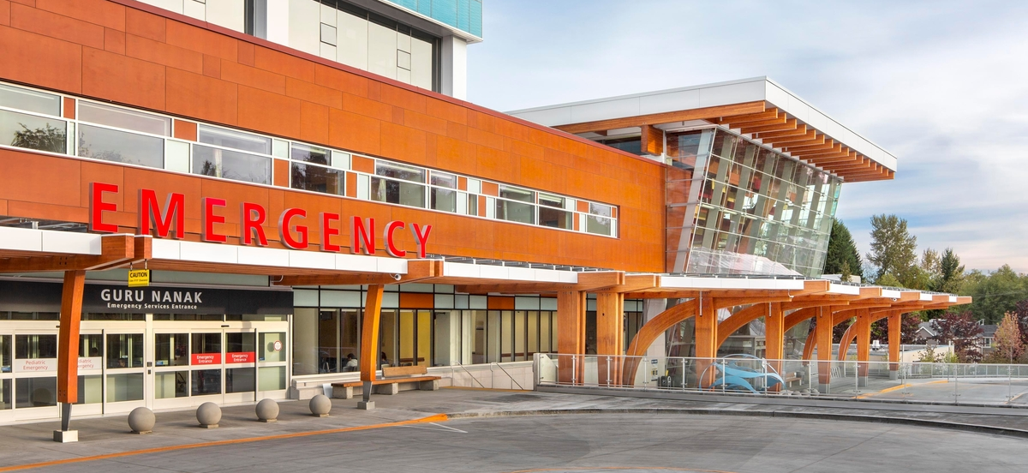
OUR COMMUNITY
City of Surrey:
Population: 568,322*
Number of FPs: 411
Average panel size: 2000 patients
Unattached Pts: 120,000
Number of hospitalists: 75 (~approx. 25/day)
Number of FPs w/ hospital privileges (excl LTC): 1
Average # of patients per day in ER: 500
*2011 Canadian Census, Statistics Canada
Notes:
Tomas to do this slide: Talk about the unique challenges of our urban population. Some of the brewing challenges that were being seen in our community regarding the relationships between community docs and hospital physicians and how this was leading up to potential challenges as we were building out our PCN plan. Transition into the division’s support for the ADC project.

Slide 4
OUR PROJECT: Admission & Discharge Communication (A.D.C.)
PROJECT GOALS:
To improve and strengthen communication between hospital-based physicians and family physicians in the community of the Surrey-North Delta.
To improve and strengthen relationships between Emergency Physicians, Family Physicians, and Hospitalists.
To improve the transition of care between acute care and primary care in the Surrey-North Delta community.
OUT OF SCOPE
Unattached patients who present to the ER.
Unattached patients who are discharged from the hospital.
Communication challenges with other areas of the hospital, such as medical imaging or out-patient clinics.
Pediatric patients presenting to the ER.

Slide 5
THE A-TEAM: Our Working Group
STAKEHOLDER | TITLE | PROJECT ROLE
Dr Mark Blinkhorn | Family physician- FP & LTC | FP Lead
Dr. Sanjay Khandelwal | SMH Department Head- Hospitalist program | SP Lead
Dr. Aydin Tavakoli | Family Physician & hospitalist | FP WG member
Dr. Brianna Noon | Family Physician & hospitalist | FP WG member
Dr. Felix Yang | Family Physician & LTC | FP WG member
Dr. Alex Yang | Family Physician & UPCC | FP WG member
Dr. Jasper Ghuman | Emergency medicine | SP WG member
Dr. Amol Lail | Emergency medicine | SP WG member
Romelly Wilson | Registration Services manager- SMH | WG member

Slide 6
External Stakeholders
STAKEHOLDER | TITLE | PROJECT ROLE (RACI)
Martha Cloutier | SMH Executive Director | Consultative, Accountable
Michelle Lane | Executive Director, Surrey Community Health Services, JPOCSC & Renal Services | Consultative
Brynn Fominoff | FHA, Regional Director- Clinical Operations, Primary Care | Consultative
Christopher MacGregor | Director, SMH ED | Consultative
Charlotte Klemencic | Clinical Operations Manager- SMH ED | Consultative
Mary Van Osch | Clinical Nurse Specialist- Emergency Network, FHA | Consultative
Dr. Sally Barrio | SMH ED Department Head | Consultative, Accountable
Dr. Craig Murray | FH Regional ED Lead | Consultative
Christopher Pinske | Independent Consultant | Consultative, Accountable
Notes:
Note the importance of having engagement with our FH partners.

Slide 7
PROJECT OVERVIEW
Notes:
Start: July 2021.
Talk about developing our action plan & what we wanted to DO.
The challenge we kept running into was related to communication breakdowns between community docs and the hospital.
Talk about workflow assessment- the value of it and the importance of having committed stakeholders

Slide 8
The development of the 4 Cs of Emergency Medicine and Family Practice
The 4 Cs:
Communication
Connection
Care
Collegiality
Video link: https://youtu.be/G6h5Wae519I
Notes:
This was originally intended to be a quick, easy CME educating physicians about some of the new tools we had developed. But this came right around the time of the pediatric surge happening in our community. And we were hearing rubmlings. So we knew we had to pivot and change directions. This lead to the sharing of some stories between our two physician leads, that precipitated the creation of what became our “4 Cs of Communication” event. (Mrs Red)

Slide 9
Session Design: Thoughtful
Designed the session to be physician-driven + interactive
Asked questions early on in the planning phase:
WHAT DO WE WANT THE ATTENDEES TO LEARN? FEEL? COME AWAY WITH?
WHAT DO WE WANT THE TONE OF THE EVENT TO BE?
Notes:
We knew this session needed to be different than anything we had done before. And we also knew that billing it as a “warm & fuzzy, let’s talk about our feelings” event wouldn’t garner the attendance or interest we knew we needed between the different parties. So we spent a fair bit of time working through the process of designing a session that was thoughtful, through, and intentional. On the thoughtful side of things…

Slide 10
Session Design: Thorough
We thoroughly discussed possible risks and came up with mitigation strategies that were practical and quickly able to implement if needed
We created a detailed facilitator’s guide to provide our working group and breakout room facilitators the confidence to manage awkward silences, potentially challenging scenarios and move the conversation towards “out of the box” solutions.
Notes:
Some of the risks identified: people wouldn’t show up (biggest risk. We had a stretch target of wanting 50 people to attend. Normally a physician education event will get about 30 or 40 people). Other risks: some people would dominate the conversation, conversations would be negative and complaining) (mitigation: detailed communication plan that included identifying who was going to reach out to whom, who was in our sphere of influence? Then we created an invite with specific messaging and with enough lead time to appropriately allow people to plan to attend. Communication channels included physician WhatsApp groups, individual invites between physician colleagues, newsletters, and email invites.

Slide 11
Session Design: Intentional
Each “section” of the event had a specific intention aligned to our overall goals of creating a space for the 4 Cs to be demonstrated:
i.e. “Intention: we want to set the foundation for the audience to find common ground with one another and create a sense of shared experiences or mutual connection to one another.”
i.e. “Intention: We want to move people from feeling connected in their shared experiences into thinking about individual solutions.”
i.e. Intention: “Solutions-focused, drawing from what works in other areas, learning from each other, audience participation and engagement”
Notes:
Why was this important? Because it allowed each facilitator to know what their “objective” was. Physicians can be task oriented. And we were asking them to lead conversations that didn’t necessarily have clear answers or outcomes. So having specific facilitator guides and intentions to fall back on, allowed our facilitators to feel confident in what we were asking them to do but it also allowed us to keep very tight to what the scope of these conversations were intended to be, without having them run away on us.

Slide 12
Why was this level of planning so important?
Video link: https://youtu.be/wHU83nXEZuU
Notes:
Dr. Khandelwal and Dr. Blinkhorn share about why the working group elected to focus on these particular 4 Cs of Communication, Connection, Care & Collegiality

Slide 13
The 4 Cs Event: Nov 30, 2022
113 people registered + 85 people attended including family physicians, hospitalists, and Emergency Medicine physicians.
Virtual event
Mix of CME credits + sessionals to reflect how the time would be spent
Scenario-based Storytelling, Break-out rooms with specific discussion questions, interactive polls,
Notes:
Hit our target of 50 attendees and then some!
Dr. Khandelwal’s quote: “we’ve spent decades doing the same thing and it isn’t working any more. We need ALL of us to come together to come up with creative, out-of-the-box ideas. The crazier the better!"

Slide 14
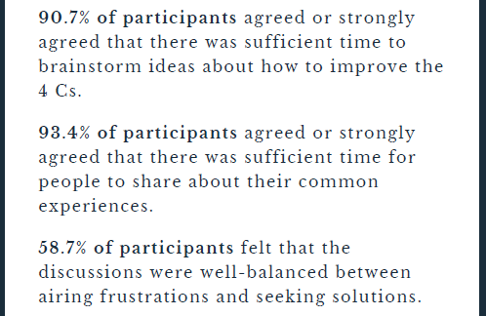
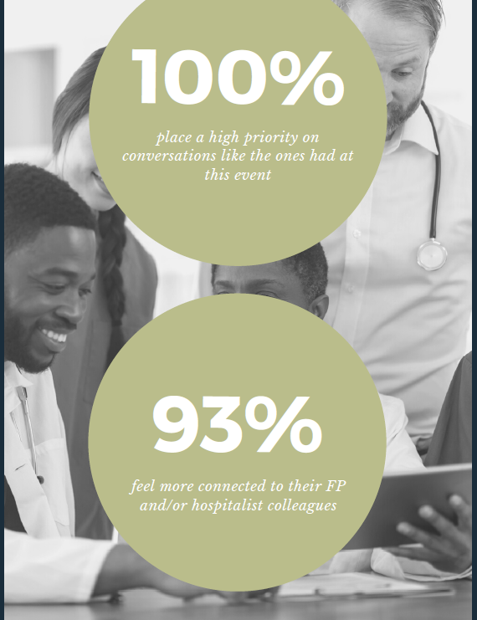
OUR SUCCESS

Slide 15
So where do we go from here?
Video link: https://youtu.be/6aWLVMe54ks
Notes:
Tomas’ PCN portion

Slide 16
THANK YOU!
Notes:
Questions: we will review Slido questions and take any we have time for. For any unanswered questions, we are committed to responding to each of them via email.

