Slide 1
No Disclosures

Slide 2
Cervical cancer screening and colposcopy in General Practice.
Screening and HPV
Colposcopy and diagnosis
Treatment and follow up

Slide 3
1. Screening and HPV Types of cervical cancer
Histological location of adenocarcinoma
and squamous cell carcinoma of the cervix
There are two main types of cervical cancer
Squamous cell carcinoma (SCC)
Adenocarcinoma
Uterine
body
Endometrium
Myometrium
Uterine cavity
Cervix
Adenocarcinoma
Endocervical canal
Squamous cell carcinoma
1. Burd EM. Clin Microbiol Rev 2003; 16:1–17;
2. Kjaer SK, et al. Epidemiol Rev 1993; 15:486–498.
Notes:
This slide describes the location and cytological features of the two main types of cervical cancer, cervical squamous cell carcinoma and adenocarcinoma. Squamous cell carcinoma is by far the more common of the two cancers:
• About 64% of cervical cancers are squamous cell carcinomas
• About 29% are adenocarcinomas
• About 10% are unspecified or other rare morphologies
References
1. Burd EM. Human papillomavirus and cervical cancer. Clin Microbiol Rev. 2003;16(1):1-17.
2. Kjaer SK, Brinton LA. Adenocarcinomas of the uterine cervix: the epidemiology of an increasing problem. Epidemiol Rev. 1993;15(2):486-498.
3.Cancer Care Ontario (Ontario Cancer Registry, 2005).

Slide 4
Screening Policy Comparison (NOT SO) NEW Implemented June 2016
 | Previous policy | NEW policy (effective June 2016)
Cervical Cancer screening
Start Age | Age 21 | Age 25
Cervical Cancer screening Interval | 2 years | 3 years
Cervical Cancer screening Stop Age | Age 69 | Age 69
Triage of positive results | Refer to colposcopy if ASC-H, AGC or HSIL+ | Refer to colposcopy if ASC-H, AGC or HSIL+
 | Repeat every 6 months for 2 years if ASCUS or LSIL | Repeat every 6 months for 1 year if ASCUS or LSIL

Slide 5
BC’s Cervical Cancer Screening Policy (NOT SO) NEW Implemented June 2016
 |  | Recommendation | Screening Interval | Balance of Harms & Benefits
Average Risk | Age 25-69 | Screen | 3 years | Benefits outweigh harms
 | Never had sexual contact* | Do not screen | N/A | Harms outweigh benefits
 | Received the HPV Vaccine | Screen | 3 years | Benefits outweigh harms
 | In same sex relationships | Screen | 3 years | Benefits outweigh harms
 | Transgender with a cervix | Screen | 3 years | Benefits outweigh harms
 | After TOTAL hysterectomy | Do not screen | N/A | Harms outweigh benefits
 | Age <25 | Do not screen | N/A | Harms outweigh benefits
 | Age >69 | Do not screen | N/A | Harms outweigh benefits
Higher than average risk | Immunocompromised women | Screen | Annual | Benefits outweigh harms
 | History of pre-cancerous lesions or cervical cancer | Screen | Annual Until 25 years after diagnosis with at least 5 negative cytology in last 10 years | Benefits outweigh harms
* Sexual contact includes intercourse as well as digital or oral sexual contact involving the genital area of a partner of either gender

Slide 6
Average Risk Screening Start Age
Cervical cancer screening should begin at age 25 (irrespective of sexual activity prior to age 25).
Evidence suggests four well-founded reasons for initiating screening at age 25:
1. Invasive cervical cancers in women younger than age 25 are rare.
> BC data 1986 – 2009 >> 1.35/100 000 age 20-24 and 7.24 cases/100 000 women ages 25 – 29¹.
> Peak incidence of cervical cancer is between 35 – 44 years of age.
2. Screening is relatively ineffective in younger women.
> Screening at a younger age is associated with an increase in false + test results and colposcopies regardless of the screening interval².
> No difference in rates of cervical cancers between countries screening < 25 years vs > 25 years of age³.

Slide 7
3. Women under 25 have a higher prevalence of lesions that often clear without treatment.
> Women < 25 years have the highest rate of infection because they have immature cervical epithelium prone to HPV infection, lack acquired immunity and engage in high risk sexual behaviour⁴.
> HPV infections generally regress in 2 years. HPV was found to persist for at least 30 months in only 9% of women < 30 years, compared to 21% of women age > 30⁵.
4. There are risks associated with unnecessary follow-up and treatments, many of which may have long-term consequences for pregnancy (ie preterm labour) or cause undue anxiety and distress⁶.
BUT regardless of age women should inform their doctor if they experience
Abnormal vaginal bleeding
Abnormal or persistent vaginal discharge
Pelvic pain or dyspareunia
Average Risk Screening Interval
Average risk women between the ages of 25-69 should be screened every three years.

Slide 8
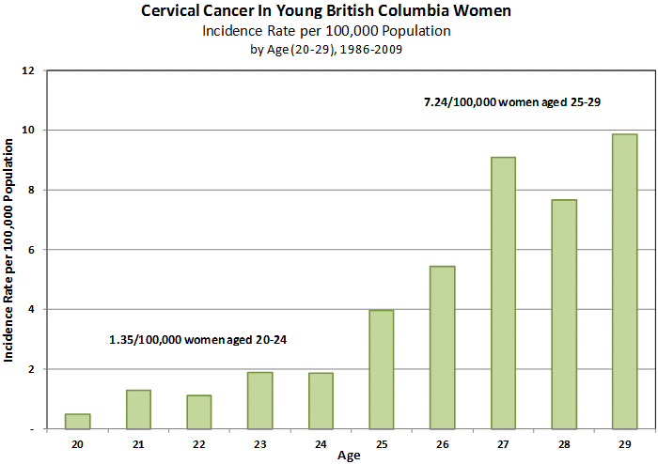
Age to Start Screening Women younger than age 25 are rare
Notes:
A more detailed analysis using B.C. data from 1986 to 2009 indicates a rate for cervical cancer of 0.50 per 100,000 women at age 20, increasing to 9.86 for women at age 29 (see following chart). The combined rate for women ages 20-24 is 1.35 and 7.24 / 100,000 for women ages 25-29.

Slide 9
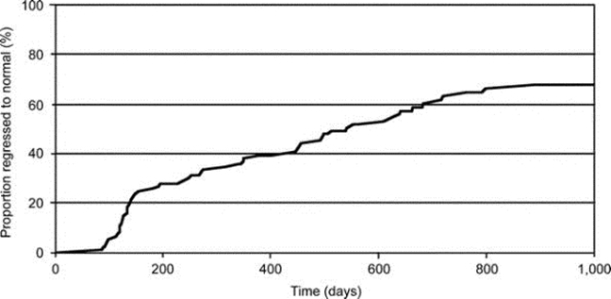
Age to Start Screening Women under 25 have a higher prevalence of lesions that clear without treatment
Regression of Cervical Intraepithelial Neoplasia 2 (CIN 2) in Young Women
Obstetrics & Gynecology. 116(6):1373-1380, December 2010.
3

Slide 10
Effect of Screening Policies on Cervical Cancer Incidence Women ages 20 -64
Age Range | Interval (Years) | Lifetime Tests | % Reduction in Incidence of Cervical Cancer | Tests per Cervical Cancer Prevented
20 - 64 | 1 | 45 | 93% | 3030
20 - 64 | 3 | 15 | 91% | 1042
25 - 64 | 3 | 13 | 90% | 917
Modified from: IRC Working Group, British Medical Journal, 1986

Slide 11
HPV infection is related to:
Almost ALL cases of cervical cancers
About 80 – 90% of anal cancers
40% of vaginal and vulva cancers
40 – 50% of penile cancers
30% of mouth and throat cancers
Almost all of genital warts

Slide 12
HPV 9 (Gardasil 9) covers nine high risk HPV types:
6 and 11: cause 90% of genital warts
16 and 18: cause 70% of cervical cancers
31, 33, 45, 52, 58: added 20% of cervical cancers
Gardasil 9 covers the HPV types which cause 90% of cervical cancers.

Slide 13
Who should get the HPV vaccine? (from HealthLink BC)
The HPV9 vaccine is provided free to girls and boys in grade 6. The vaccine is being offered to boys in grade 6 for the first time starting in September 2017.
Females born in 1994 or later who were not immunized in the school-based program, or did not complete their vaccine series, can also get the HPV9 vaccine. Also free for individuals who are HIV +, transgender, males who are street involved, males who have sex with males, including those who may not yet be sexually active and are questioning their sexual orientation.
The HPV9 vaccine is recommended, but not provided free, for the following individuals:
Women 45 years of age and younger born prior to 1994
Boys and men 9 to 26 years of age
Men 27 years of age and older who have sex with men

Slide 14
The HPV vaccines are given as a series of either 2 or 3 doses over a 6 month period. Children who start a series when they are 9 to 14 years of age need 2 doses given at least 6 months apart. People who start a series when they are 15 years of age and older and those with a weakened immune system need 3 doses.
Those not eligible for free HPV vaccine can purchase it at most pharmacies and travel clinics.
Cranbrook pharmacy: Gardasil 9 x 3 dosages: Total $575 or $205 per dose.
It is best to get immunized before becoming sexually active and coming in contact with HPV, because the vaccines prevent infection but do not clear it.

Slide 15
Children for HPV vaccination: Grade 6
Adults: 1st dosage, then 2 months later, then at 6 months

Slide 16
What is the link between HPV and cervical cancer?
Evidence has now confirmed that long term persistent hr-HPV infection is necessary for the development of cervical cancer⁷.
HPV is transmitted sexually, primarily through intercourse (vaginal or anal).
Transmission requires skin to skin contact and intercourse is not a pre-requisite⁸. HPV infection is highly prevalent and most individuals will be infected with HPV at some point in their lives, with a 75% lifetime risk of infection.
Of the more than 100 known types of HPV, 15 can be defined as high-risk (hr-HPV) types and can cause cervical cancer⁹.
The two most prevalent hr-HPV types (associated with 70% of cervical cancers) are HPV-16 and 18⁸. Low-risk HPV (lr-HPV) types cause anogenital warts and are not associated with cervical cancer or its precursors. The two most common lr-HPV types are HPV-6 and 11.
.

Slide 17
The majority of HPV infections are cleared by the body’s immune system within about 2 years. This is particularly the case in adolescents and women under the age of 30¹⁰¹¹¹².
Research has found that long-term infection with hr-HPV types may lead to cervical dysplasia which can progress to cervical cancer if left undetected or untreated¹³¹⁴.
It typically takes 10 to 15 years from the time of an initial hr-HPV infection until a cancer forms. It is not possible to predict which pre-cancerous lesions will become a cancer and which will regress. As a result, the threshold for treatment in BC is CIN 2.

Slide 18
How long does it take for cervical cancer to develop?
Once cervical cells begin to change, it typically takes 10-15 years for invasive cervical cancer to develop. As the cells change, they first become cervical intraepithelial neoplasia (CIN) grade 2 or 3. Given the threshold for treatment in BC is CIN 2 (moderate dysplasia), the incidence of invasive cervical cancer in BC is rare.
Cervical cancers usually develop very slowly, starting with cellular atypia due to infection with oncogenic (high-risk) types of the human papillomavirus (hr-HPV), then cervical dysplasia, and finally invasive cervical cancer. The pre-cancerous lesions are usually detectable through screening and are treatable in the majority of cases. In most cases, it takes years for these lesions to turn into cervical cancer.
In a widely publicized study from New Zealand, progression to invasive carcinoma was 30% at 30 years in women who were left untreated after a histological diagnosis of CIN 3¹⁵ .

Slide 19
Cancers of the cervix mainly include carcinomas of the mucosal epithelium, especially squamous cell carcinoma (up to 80% of cases) and adenocarcinoma (which occur in glandular cells)¹⁶¹⁷.
In Canada, for example, the age-adjusted incidence for squamous cell carcinoma of the cervix declined from 11.1 per 100,000 women to 5.3 between 1970 and 1996¹⁸.

Slide 20
BC’s Cervical Cancer Screening Policy Higher than Average Risk - NEW Implemented June 2016 http://www.bccancer.bc.ca/screening/Documents/CCSP_GuidelinesManual-ScreeningRecommendationsHighRisk.pdf
 | CATEGORIES | SCREENING Recommendation | RETURN TO NORMAL SCREENING AFTER | SCREENING STOP AGE
Higher than average risk | Immunocompromised individuals:
 | Including those with human immunodeficiency virus (HIV/AIDS), lymphoproliferative disorders, organ transplants, and those under long-term immunosuppression therapy | Annual screening | Never | The benefits of screening beyond age 69 must be weighed in the context of the overall health of the patient
 | Previous cytological diagnosis of HSIL+ (or worse) or histological diagnosis of CIN 2+:
 | CIN 2+ (not including AIS): treated (cone, LEEP, ablative therapy), HPV negative, discharged from colposcopy | Follow average risk guidelines | N/A | Age 69 or 25 years since most recent diagnosis with at least 3 Paps with no significant abnormality* in last 10 years – whichever occurs later
 | CIN 2+ (not including AIS): treated (cone, LEEP, ablative therapy), HPV positive, discharged from colposcopy | Annual screening | At least 3 negative Paps in last 5 years | Age 69 or 25 years since most recent diagnosis with at least 3 Paps with no significant abnormality* in last 10 years – whichever occurs later
 | CIN 2+ (not including AIS): untreated (regressed and discharged) | Annual screening | At least 3 negative Paps in last 5 years | Age 69 or 25 years since most recent diagnosis with at least 3 Paps with no significant abnormality* in last 10 years – whichever occurs later
 | CIN 2+ (includes AIS): untreated and lost to follow-up | Refer to colposcopy for assessment | N/A | Age 69 or 25 years since most recent diagnosis with at least 3 Paps with no significant abnormality* in last 10 years – whichever occurs later
 | Adenocarcinoma in situ (AIS) treated with LEEP or cone biopsy and discharged from colposcopy | Annual screening | 25 years after the most recent histological evidence of AIS | Age 69 or 25 years since most recent diagnosis with at least 3 Paps with no significant abnormality* in last 10 years – whichever occurs later
 | Invasive Cervical Cancer and Annual screening discharged from colposcopy or the BC Cancer Agency | Annual screening | At least 3 negative Paps in last 5 years | Age 69 or 25 years since most recent diagnosis with at least 3 Paps with no significant abnormality* in last 10 years – whichever occurs later
* significant abnormality is anything more severe than ASCUS/LSIL

Slide 21
BC’s Cervical Cancer Screening Policy Higher than Average Risk - NEW Implemented June 2016 http://www.bccancer.bc.ca/screening/Documents/CCSP_GuidelinesManual-ScreeningRecommendationsHighRisk.pdf
 | CATEGORIES | SCREENING Recommendation | RETURN TO NORMAL SCREENING AFTER | SCREENING STOP AGE
Higher than average risk | Previous cytological diagnosis of HSIL + (or worse):
 | HSIL: CIN 1 or negative at initial colposcopy, no subsequent biopsy or follow-up | Refer to colposcopy for assessment | N/A | Age 69 with at least 3 Paps with no significant abnormality* in last 10 years
 | HSIL: CIN 1 or negative at colposcopy, discharged from colposcopy | Annual screening | At least 3 negative Paps in last 5 years | Age 69 with at least 3 Paps with no significant abnormality* in last 10 years
 | Adenocarcinoma in situ (AIS) cytological diagnosis. CIN 1 or negative at colposcopy, discharged from colposcopy. | Annual screening | 25 years after the most recent cytological evidence of AIS | Age 69 or 25 years since most recent diagnosis with at least 3 Paps with no significant abnormality* in last 10 years – whichever occurs later
 | Total hysterectomy (with the cervix removed) and a history of:
 | Invasive cervical cancer Histologically proven CIN 2+ (including AIS) at colposcopy or hysterectomy Histologically proven VAIN 2+ | Vaginal vault smear annually | At least 3 negative Paps in last 5 years | Age 69 or 25 years since most recent diagnosis with at least 3 Paps with no significant abnormality* in last 10 years – whichever occurs later
 | Cytological diagnosis of HSIL + (includes AIS): CIN 1 or negative at hysterectomy | Vaginal vault smear annually | N/A | At least 3 negative Paps in last 5 years
 | High risk behaviors
 | Individuals who participate in high risk behaviors | Follow average risk guidelines | N/A | N/A
* significant abnormality is anything more severe than ASCUS/LSIL

Slide 22
2. Colposcopy and diagnosis:
What is colposcopy?
Colposcopy is a procedure used to examine the cervix, vagina and vulva. We use a special microscope called a colposcope to look for abnormalities. During the colposcopy we will almost always take a biopsy from any areas that appear abnormal.
What happens during the colposcopy?
The exam starts off much like a Pap test: a speculum to gently spread the vaginal walls to get a better look at the cervix.
Vinegar (acetic acid) or iodine may be applied to the cervix to make any abnormalities more visible. We will then take (at least) one biopsy from the cervix (or vagina / vulva) for histology. The procedure is done in 5-10 minutes.
What happens after the colposcopy?
There may be some spotting if a biopsy was taken which should stop within 24-48 hours. If a tampon is used to protect from spotting, ensure it is removed three hours after insertion. If you experience further spotting another tampon can be inserted or a pad may be used.

Slide 24
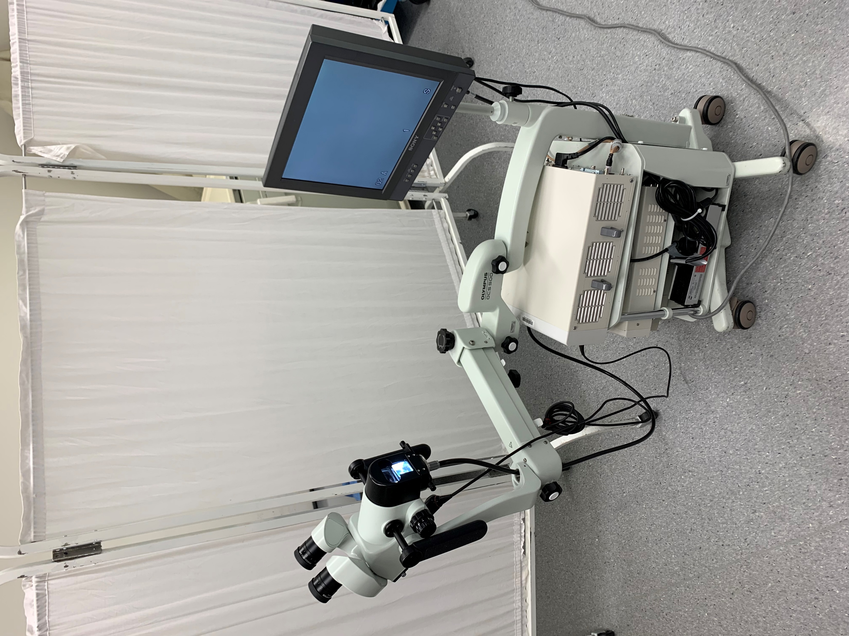

Slide 25
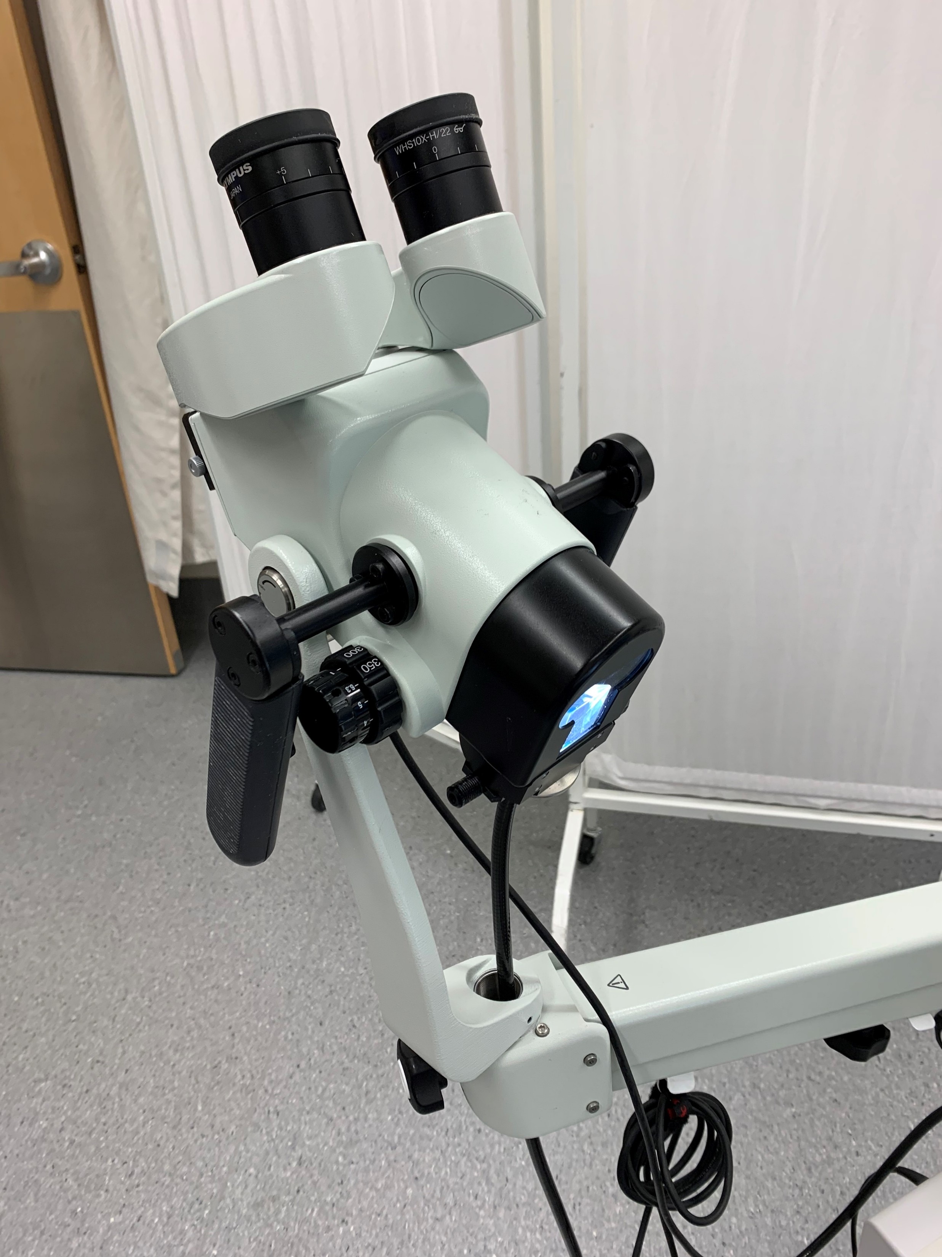

Slide 26
Reasons to refer to colposcopy clinic:
Abnormal Pap smears:
ASCUS/LSIL persistent over 12 months because PPV (positive predictive value) of ASCUS/LSIL for CIN2+ is 15-25%.
ASC-H because PPV of ASC-H for CIN2+ is 50 – 60%.
HSIL because PPV of HSIL for CIN2+ is 70 – 80%.
AGC-NOS because PPV of AGC-NOS for CIN2+ is 20 – 30%.
AGC-N because PPV of AGC-N for CIN2+ is 70 – 80%.
All Paps with Atypical endometrial cells also for colposcopy / endometrial biopsy / ECC
Unsatisfactory Paps for 2 years.
Adenocarcinoma in situ (AIS).
Squamous cell carcinoma, adenocarcinoma or other malignancy.
Patients with a history of intrauterine diethylstilbestrol (DES) exposure
Post coital bleeding / abnormal vaginal bleeding or discharge
Abnormal looking cervix

Slide 27
Colposcopy biopsy results:
LSIL
HSIL (CIN2 or CIN3 = Squamous carcinoma in situ)
Squamous carcinoma
Adenocarcinoma in situ
Adenocarcinoma

Slide 28
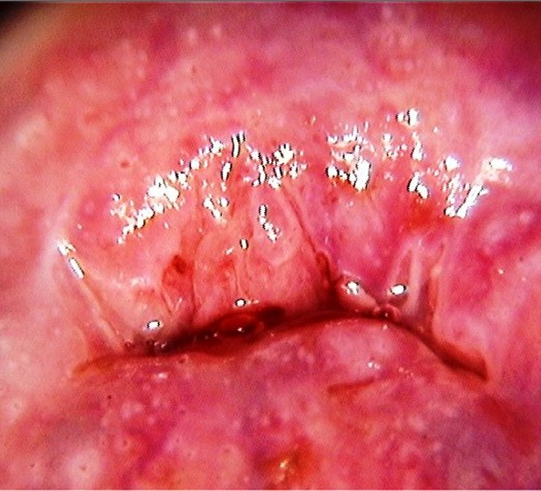
Normal Cervix at Colposcopy

Slide 29
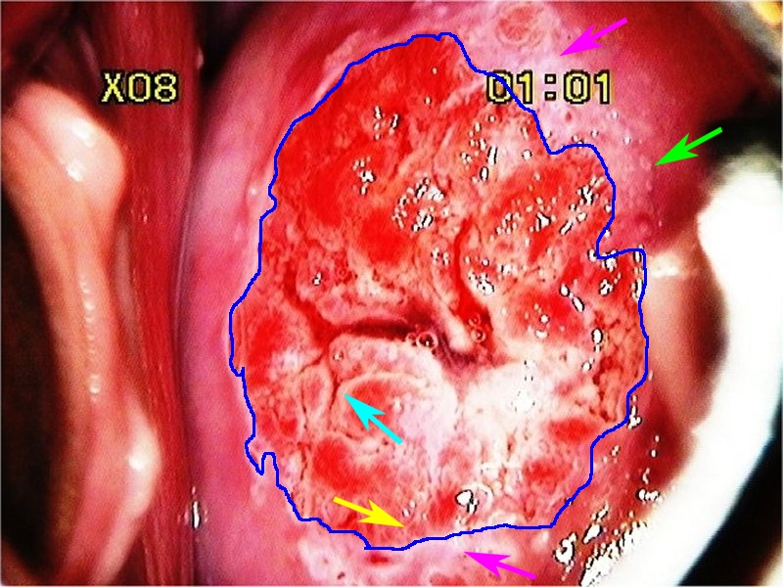
Normal cervix:
Dark blue line: SCJ
Yellow: columnar epithelium
Blue: fissure between columnar epithelium
Green: crypt opening
Purple: metaplasia

Slide 30
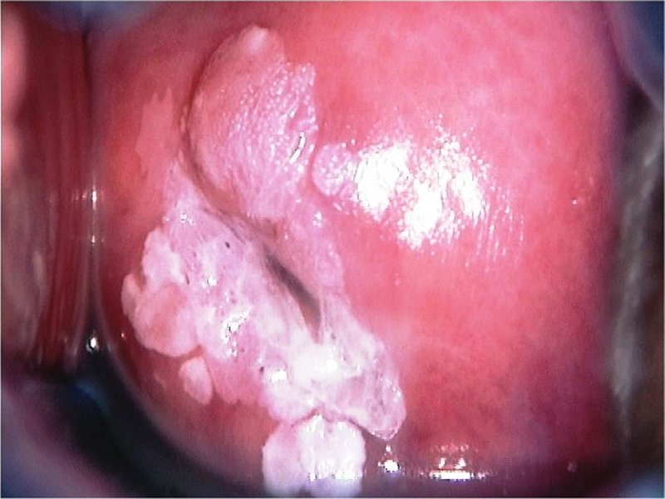
LSIL with condylomata

Slide 31
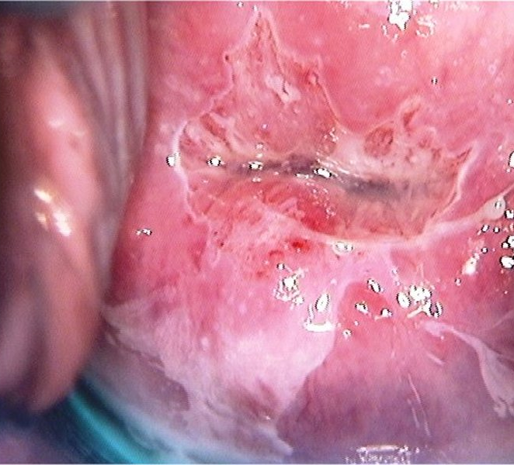
LSIL

Slide 32
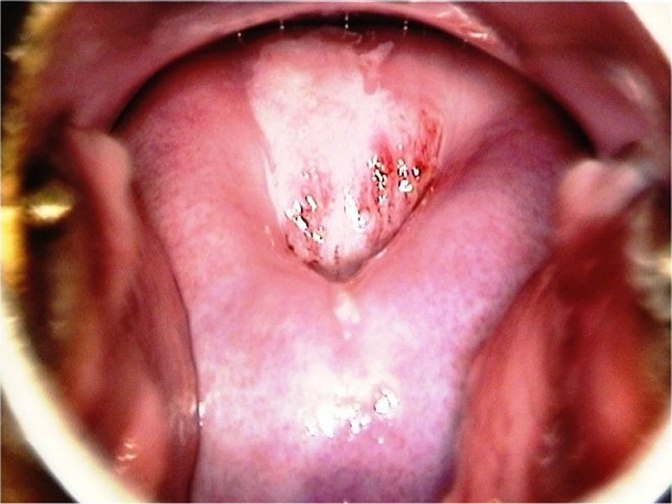
HSIL with TYPE 2 TRANSFORMATION ZONE

Slide 33
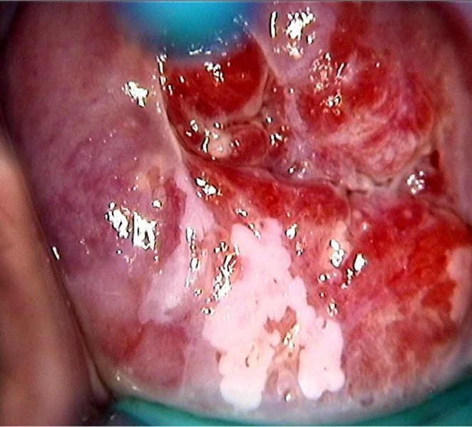
HSIL with TYPE 1 TRANSFORMATION ZONE

Slide 34
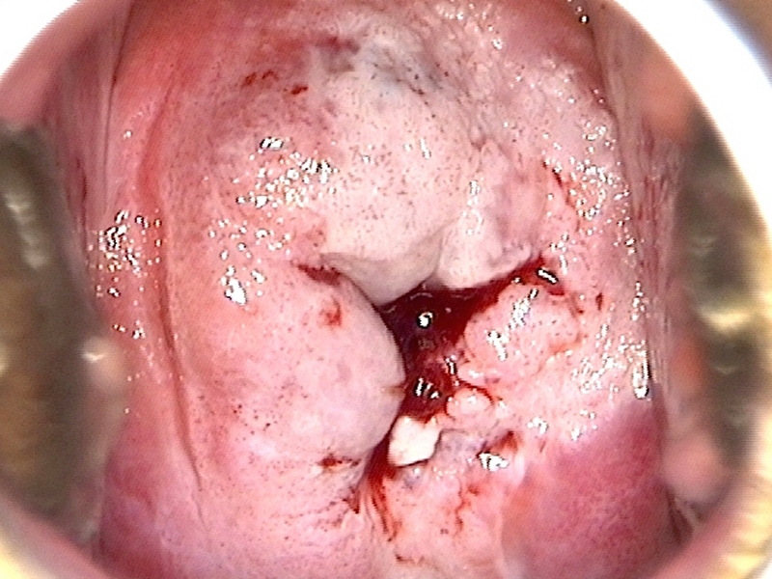
Squamous Carcinoma

Slide 35
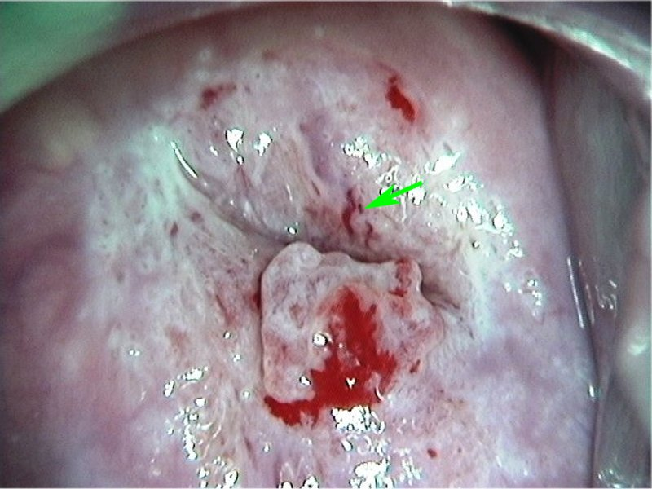
Adenocarcinoma in situ
Green arrow: abnormal blood vessel

Slide 36
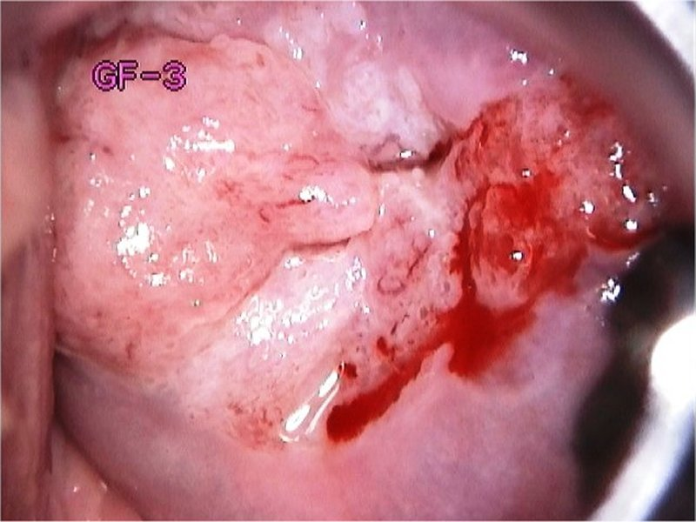
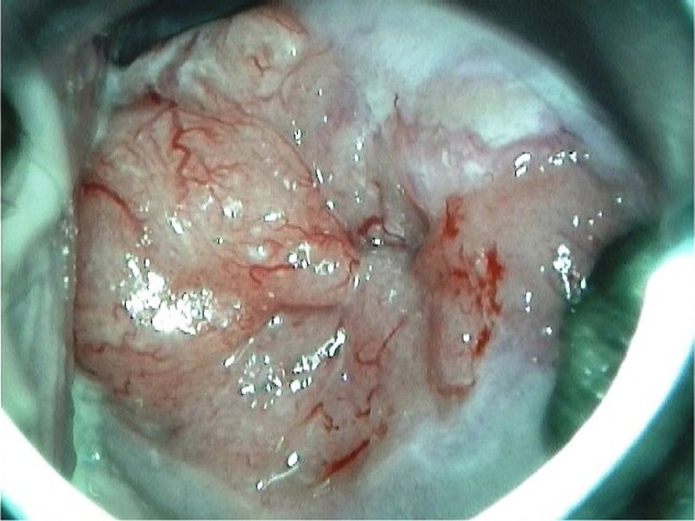
Adenocarcinoma

Slide 37
3. Treatment and follow up
What is a LEEP (Loop Electrical Excision Procedure)?
A LEEP involves removing abnormal tissue from the cervix using a thin wire loop. It is usually done within eight weeks of diagnosis. Over 90% of women will only require one LEEP to remove any abnormal tissue.
What happens during a LEEP?
We usually again look at the cervix using the colposcope.
A small amount of vinegar or iodine will be placed on the cervix to make any abnormalities more visible.
Local freezing (1% lidocaine with epinephrine) is then giving to the cervix as a paracervical block. Some people feel a pinch or cramp or discomfort when the freezing is done. The lidocaine / epinephrine will make the heart beat a little faster, but it’s not dangerous, and it will pass within a few minutes.
A thin wire loop is then used to remove abnormal tissue. The cervix is then cauterized.
To reduce any bleeding, a brown paste (Monsels) may be placed on the cervix. The paste comes out later looking brown or black, which is normal.
The procedure usually lasts less than five minutes.

Slide 39
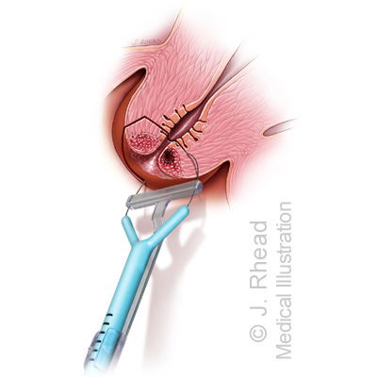
Doing the LEEP

Slide 40
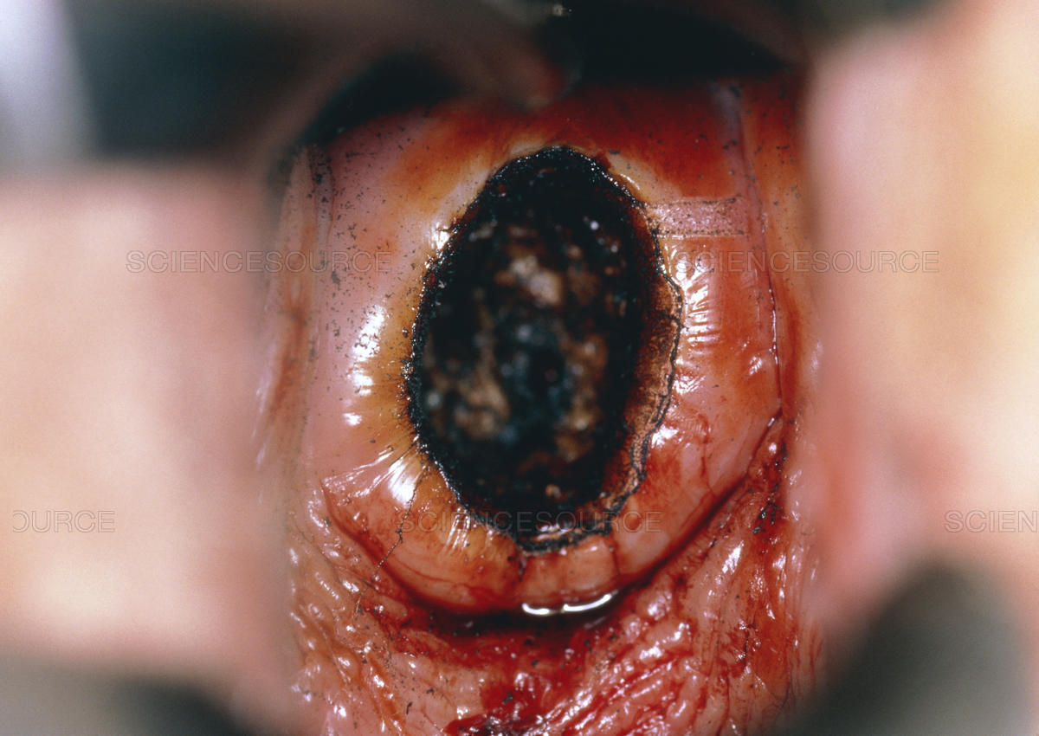

Slide 41
Why get treatment: > To treat disease > To exclude (micro)invasive cancer
ALL patients over 25 with HSIL are offered a LEEP because we do not know which lesion will progress to cancer.
It is a discussion with, and a reasonable option to follow women < 25 years old with HSIL for up to 24 months OR up to the age of 25 (whichever comes first).
If lesion regresses to LSIL or negative then discharge with Pap in 6 months. If lesion persists > 24 months or patient attains 25 years then LEEP

Slide 42
Risks and side effects:
Abdominal cramping
Infection
Bleeding
Future pregnancy problems (small increased risk of premature birth and having a low birth weight baby)
Incomplete removal of the abnormal tissue
Accidental cutting or burning of normal tissue
Narrowing/stenosis of the cervix (rare)

Slide 43
Then we get the Histology results about 2 weeks later:
LSIL
HSIL (CIN3 = Squamous carcinoma in situ)
Squamous carcinoma
Adenocarcinoma in situ
Adenocarcinoma
For example: LEEP HSIL and complete margins are seen again at 6 months in colposcopy clinic for colposcopy / ECC / HPV

Slide 44
REFERENCES:
1. Canadian Task Force on Preventive Health Care, Recommendations on screening for cervical cancer. CMAJ. 2013 Jan
8;185(1):35-45.
2. Kulasingam S, Havrilesky L, Ghebre R et al. Screening for Cervical Cancer: A Decision Analysis for the U.S. Preventive Services Task Force. 2011. Available at
http://www.uspreventiveservicestaskforce.org/uspstf11/cervcancer/cervcanceres.pdf. Accessed January 2012.
3. Landy R, Birke H, Castanon A et al. Benefits and harms of cervical screening from age 20 years compared with screening from age 25 years. British Journal of
Cancer. 2014; 110(7): 1841-6.
4. Jayasinghe YL, Moore EE, Tabrizi SN et al. Human papillomavirus in adolescents: lessons learned from decades of evaluation. Journal of Paediatrics and Child
Health. 2013; 49(2): 99-104.
5. Rodriguez AC, Schiffman M, Herrero R et al. Rapid clearance of human papillomavirus and implications for clinical focus on persistent infections. Journal of the
National Cancer Institute. 2008; 100(7): 513-7.
6. Arbyn M, Kyrgiou M, Simoens C, Raifu AO, Koliopoulos G, Martin-Hirsch P, Prendiville W, Paraskevaidis E. Perinatal mortality and other severe adverse pregnancy
outcomes associated with treatment of cervical intraepithelial neoplasia: meta-analysis. BMJ. 2008 Sep 18;337:a1284
7. Walboomers JM, Jacobs MV, Manos MM, Bosch FX, Kummer JA, Shah KV, et al. Human papillomavirus is a necessary cause of invasive cervical cancer worldwide. J Pathol 1999 Sep;189(1):12-19.
8. Stanley, M. Pathology and epidemiology of HPV infection in females. Gyne Onc. 2010; 117: S5-S10
9. Arbyn M, Tommasino M, Depuydt C et al. Are 20 human papillomavirus types causing cervical cancer? Journal of Pathology. 2014; 234(4): 431-5.

Slide 45
10. Moscicki AB, Shiboski S, Broering J et al. The natural history of human papillomavirus infection as measured by repeated DNA testing in adolescent and young women. The Journal of Pediatrics. 1998; 132(2): 277-84.
11. Woodman CB, Collins S, Winter H et al. Natural history of cervical human papillomavirus infection in young women: a longitudinal cohort study. The Lancet. 2001; 357(9271): 1831-6.
12. Moscicki AB. Management of adolescents who have abnormal cytology and histology. Obstetrics and Gynecology Clinics of North America. 2008; 35(4): 633-43; x.
13. Kjaer SK, van den Brule AJ, Paull G et al. Type specific persistence of high risk human papillomavirus (HPV) as indicator of high grade cervical squamous intraepithelial lesions in young women: population based prospective follow up study. BMJ. 2002; 325(7364): 572.
14. Kjær SK, Frederiksen K, Munk C et al. Long-term absolute risk of cervical intraepithelial neoplasia grade 3 or worse following human papillomavirus infection: role of persistence. Journal of the National Cancer Institute. 2010; 102(19): 1478-88
15. McCredie MR, Sharples KJ, Paul C, Baranyai J, Medley G, Jones RW, Skegg DC.Natural history of cervical neoplasia and risk of invasive cancer in women with cervical intraepithelial neoplasia 3: a retrospective cohort study. Lancet Oncol. 2008 May;9(5):425-34
16. Brinton LA, Tashima KT, Lehman HF et al. Epidemiology of cervical cancer by cell type. Cancer Research. 1987; 47(6): 1706-11.
17. Copeland G, Datta SD, Spivak G et al. Total burden and incidence of in situ and invasive cervical carcinoma in Michigan, 1985-2003. Cancer. 2008; 113(10 Suppl): 2946-54.
18. Liu S, Semenciw R, Probert A et al. Cervical cancer in Canada: changing patterns in incidence and mortality. International Journal of Gynecological Cancer. 2001; 11(1): 24-31. 6 Smith HO, Tiffany MF, Qualls CR et al.

Slide 46
Resources – Provider and Patient
http://www.bccancer.bc.ca/screening/health-professionals/cervix
http://www.bccancer.bc.ca/screening/health-professionals/cervix/colposcopy#Resources
HPV FOCAL FAQ
http://www.bccancer.bc.ca/our-research/participate/cervical-screening
www.sexualityandu.ca
www.hpvinfo.ca
http://immunizebc.ca/diseases-vaccinations/hpv
NACI (National Advisory Committee on Immunization) Guidelines:
http://www.phac-aspc.gc.ca/naci-ccni/index-eng.php

