Slide 1
What’s The Deal with this new chemotherapy?
Keith Lowden, MD
GP in Oncology
BC Cancer

Slide 2
Disclosures
Speaking fee for Servier
Will not be discussing off-label use of any medications

Slide 3
Learning Objectives
Recognize the evolving nature of cancer chemotherapy
Differentiate cytotoxic, molecular targeted, and immunotherapies
Formulate a plan for dealing with the common toxicities of immunotherapy check-point inhibitors

Slide 4
Cancer Treatment Modalities
Traditional
Surgery
Radiotherapy
Conventional Chemotherapy
Modern
Molecularly Targeted Therapies
Immunotherapy

Slide 5
But Dr. Google and all those other treatments on the internet? Correlation Does Not Equal Causation

Slide 6
The History of Chemotherapy

Slide 7
Conventional Chemotherapy Molecules
Cell cycle disruption, DNA replication, RNA transcription, microtubule disruption, mitotic enzymatic changes
Cyclophosphamide
Paclitaxel

Slide 8
Molecularly Targeted Therapy
The “ib” drugs
Cell Surface Receptors targeted by chemical agents
EGFR, Erlotinib for lung, pancreatic
ALK, Crizotinib for lung,
TK, Multiple drugs, sunitinib for renal, imatinib for CML, GIST
CDK4/6, Palbociclib for breast
BRAF, MEK1/2, Dabrafenib and trametinib for melanoma

Slide 9
Molecular Targeted Complexity
Crizotinib
Sunitinib

Slide 10
And Now Immunotherapy
Samuresh Sau, PD-1 and PD-L1 Checkpoint Signaling Inhibition for Cancer Immunotherapy: Mechanism, Combinations, and Clinical Outcome, 2017

Slide 11
Immunotherapy Utilizes Monoclonal Antibodies
Maria Connolly, The Chemistry of Monoclonal Antibodies, BathASU

Slide 12
Complexity of Immunotherapy EGFR Pathway Map
Kanae Oda, Yukiko Matsuoka, Hiroaki Kitan. The Systems Biology Institute, 2005

Slide 13
Complexity of Immunotherapy
Maria Connolly, The Chemistry of Monoclonal Antibodies, BathASU

Slide 14
Immunotherapy
Monoclonal Antibodies (mab’s)
Rituximab, Panitumumab, Cetuximab, Daratumumab, Trastuzumab, Pertuzumab
Radio-immune therapy
90Y-ibritumomab tiuxetan
Immune Checkpoint Inhibitors
Nivolumab, Ipilimumab, Pembrolizumab
CAR-T cell therapy
KYMRIAHTM (tisagenlecleucel)
YESCARTATM (axicabtagene ciloleucel)

Slide 15
Radio-immunotherapy
Courtesy of Servier

Slide 16
Immune Checkpoint Inhibitors

Slide 17
Toxicities of Checkpoint Inhibition
Choose an organ or body system, and add “itis”
Encephalitis, hypophysitis, ophthalmitis, thyroiditis, myocarditis, pneumonitis, hepatitis, pancreatitis, colitis, nephritis, arthritis, myositis, neuritis, dermatitis
Others are infusion reactions, fatigue, and adrenal insufficiency
These toxicities are NOT like our usual chemotherapy issues

Slide 18
Treatment of Immune Toxicities
Patients are given a card or letter to present to the ER department
Advises Physician to discuss with the Oncologist on Call from Kelowna
Utilize appropriate Specialist Physicians
Grade 1/2 (mild to moderate): withhold and resume when toxicity is grade 1 or less. Corticosteroids (prednisone 0.5 mg/kg/day or equivalent) should be started if symptoms do not resolve within a week.
Grade 3/4 (severe or life threatening): treatment permanently discontinued. High doses of corticosteroids (prednisone 1 to 2 mg/kg/day or equivalent) should be given. When symptoms subside to grade 1 or less, steroids can be gradually tapered over at least one month

Slide 19
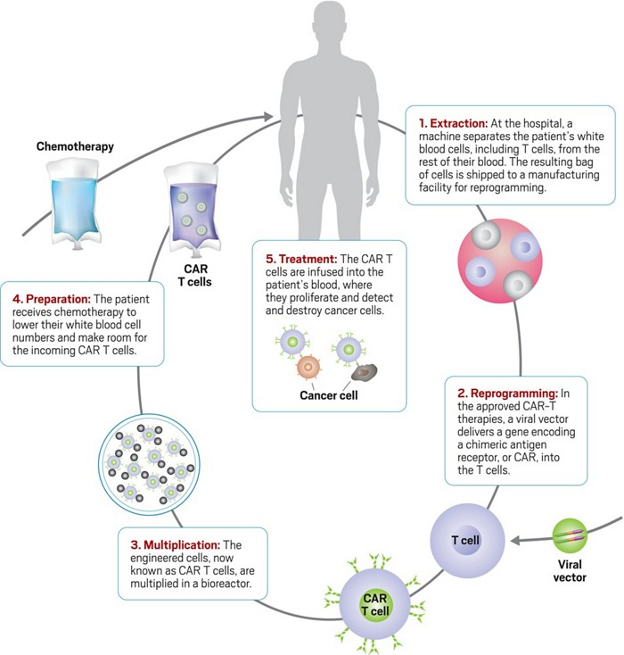
CAR-T Cell Therapy
Credit Yang Ku

Slide 20
CAR-T Therapy
Used now for lymphoma/leukemia
Lots of presenting surface antigens to target
Not so promising for solid tumours
Unique Antigens needed
Most are internal and presented by MHC
Toxicity
Cytokine Release Syndrome
Neurotixicity: edema, seizures, encephalopathy
Hypotension
Other systemic symptoms

Slide 21
Other Adoptive Cell Therapies on the Horizon
Ex-vivo expansion of tumor-infiltrating lymphocytes — (TILs) represent an immune cell population that still recognizes tumor antigen but has developed an exhausted phenotype due to the tumor microenvironment.
Bispecific T cell engagers — (BiTEs) function to link T cells and specific target antigens in an MHC-subtype independent manner.

Slide 22
Monoclonal TCRs — Another approach to increasing effector T cell function against a particular antigen is engineering a soluble TCR (CD8) to recognize a particular antigen target and fusing this to the variable fragment that recognizes an effector target, such as CD3
Oncolytic viruses — Oncolytic viruses can be engineered to efficiently infect cancer cells preferentially over normal cells, to promote presentation of tumor-associated antigens, to activate "danger signals" in the microenvironment
Therapies directed at other cell types in tumor microenvironment — In tumor immunology, other cell types contribute to an effective rather than a suppressed immune response, representing additional targets for immunotherapy beyond T cells.

Slide 23
Herbals and Supplements
Memorial Sloan Kettering Cancer Center

Slide 24
Does Cannabis Cure Cancer?
No
BC Cancer symptom management
Nausea, anorexia, pain, peripheral neuropathy, anxiety, insomnia
Sativa to Change the things I can
Indica to Accept the things I can’t

Slide 25
Thank You and Questions
So, what’s the deal with this new chemotherapy?
It’s not really chemo, and the providers
should probably be in therapy

