Slide 1
Care of Gender Diverse and Trans Children and Youth

Slide 2
Disclosure:
I have nothing to disclose

Slide 3
Learning Objectives
Increasing understanding of the health needs of trans,gender divers, gender creative children and youth
Enhance understanding of the role of primary care providers within a tiered model of service

Slide 4
Gender dysphoria: Discomfort or distress that is caused by a discrepancy in a person`s gender and that of that person`s sex assigned at birth
Can present at any age
Trans-Gender : gender identity different than their assigned gender at birth
vs Cis-gender: someone who`s gender identity matches their assigned gender at birth

Slide 5
Incidence
No formal epidemiological studies
1:12000- 1:45000 ( MTF)
1:30 000-1:200 000 (FTM)

Slide 6
Historical
Non-binary and 3rd gender people present in every ancient civilization on every continent, documentation dating back as long as 9000 years
Some Native American tribes known to have a 3rd gender before any western contact.
Their social roles differed between tribes ( priests to prostitutes)
Since the 1900`s some North American tribes referred to “Two-Spirit people”

Slide 7
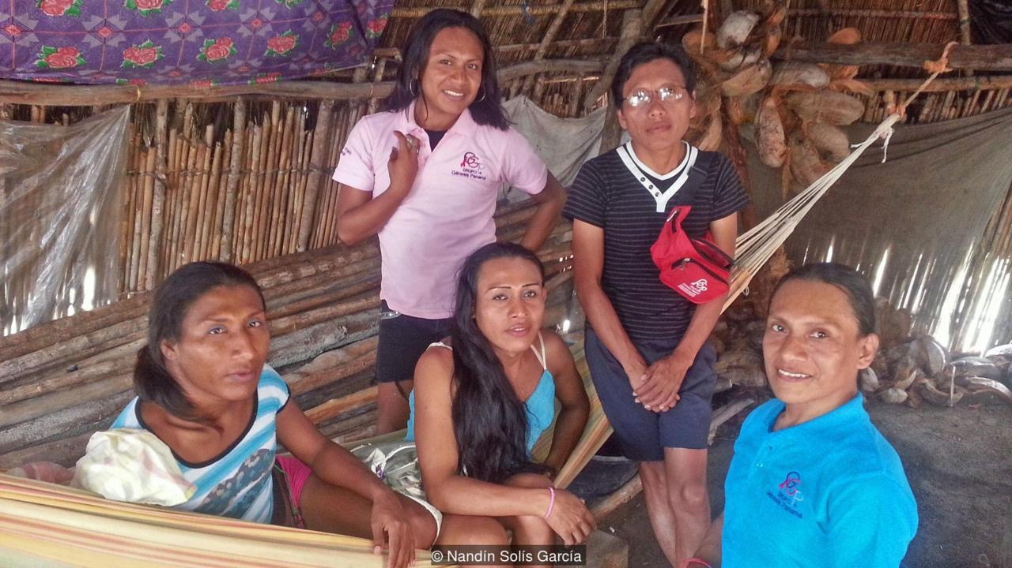

Slide 8
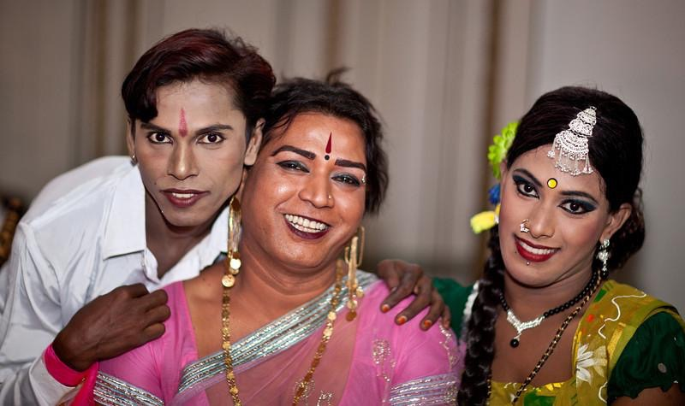

Slide 9
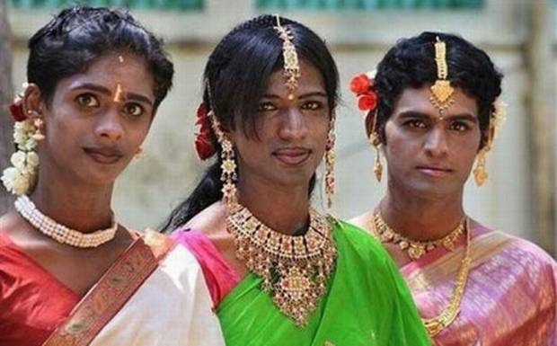

Slide 12
Developmental aspect of Gender Identity
Gender begins at conception
Biologically based( neurologic and anatomic)
“Neurologic” ( gender identity) vs “Anatomic” ( physical /sex characteristics) may be fully/partially congruent or completely incongruent
There develops a coherent/incoherent sense between self and gender as the child develops

Slide 17
Gender Non-conformity in Children
Gender non-conformity may become evident in the toddler years
Gender dysphoria may present as early as age 2

Slide 32
Trans Youth Health Survey
completed between Oct 2013-May 2014
15% felt comfortable to discuss transgender specific health care needs with their primary health care provider
1/3 of younger ( 14-18yr old) and 1/2 of the older both ( 19-25) reported missing needed physical health care during the past year and even more missed needed mental health care

Slide 33
Gender -Affirming approach
Creating a welcome clinic environment
using inclusive and affirming language
being prepared to enquire about gender development and gender diversity
having basic knowledge about social medical and surgical interventions that are available for gender dysphoria
considering the ways that gender diverse youth may be vulnerable to health and social disparities
maintaining a trauma-informed approach

Slide 34
SCREENING
SAVES
LIVES
Ask about gender!!

Slide 45
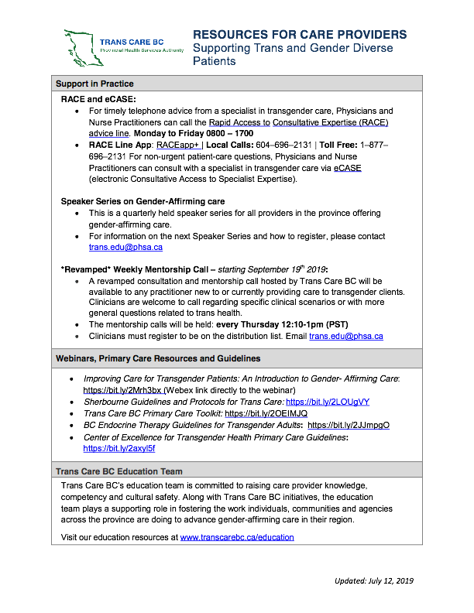

Slide 46
Questions?

