Slide 1
Westshore Community Health Center
Presentation to PCN Physicians’ Forum
2 Nov 2020
Dr Jennifer Ross/Dr Randal Mason

Slide 2
CHCs
Are multi-sector not for profit organizations providing a population with primary care, including services to support the social determinants of health
Provide team based interdisciplinary primary care
Integrate diverse health and social services
Community-centered and patient-focused
Demonstrate a commitment to health equity, cultural safety and humility, and social justice

Slide 3
Community need
Attachment gap (2016): 36475
Attachment gap (2023 projected): 65064
Unattachment rates range 31-39% of the population
Most prevalent conditions:
HTN, asthma, anxiety/depression, OA and DM
Attachment worst for people with chronic conditions and MHSU

Slide 4
Partner organizations
Providing mental health and community services in the Westshore since 1968
Providing low barrier, trauma informed, team-based care for people living with substance use disorders, in the Westshore, since 2017

Slide 5
CHC planning committee
PCFSA
AVI
BCACHC
Patient partners
Meeting bi-weekly since April 2020

Slide 6
Priority populations
Priority populations for the Westshore Community Health Centre will be individuals of all ages and their families who experience barriers to health/health care due to the impact of inequity and the Social Determinants of Health which include: income, employment and working conditions, education/literacy, childhood experiences, built environment, lack of social supports, colonization, gender/race/class based discrimination and the intersection of same. Groups that typically experience these impacts disproportionately in the Westshore include:
People with moderate to severe mental health conditions
People with substance use disorders
Seniors
People with multiple chronic health conditions
People who identify as Indigenous
Gender diverse/LGBTQ2S people

Slide 7
Service delivery model – primary care team
Patient and family
FP/NP
RN
MOA
CHW
Longitudinal, relationship-based care
Low barrier/trauma informed
Extended hours (8-8, weekends)
Leverage virtual care
Outreach team M-F

Slide 8
Clinic wide resources/PCN shared
Primary care team and patient
MH Counsellors
AVI team
PCN pharmacist
PCN Social work
Leverage PCFSA existing mental health infrastructure
Leverage AVI addiction medicine and team-based care expertise
Co-locate with PCN SW and pharmacist

Slide 9
PCN attachment gap - total | CHC attachment target | CHC attachment as % of total PCN attachment gap
36475 | 7788 | 21%

Slide 10
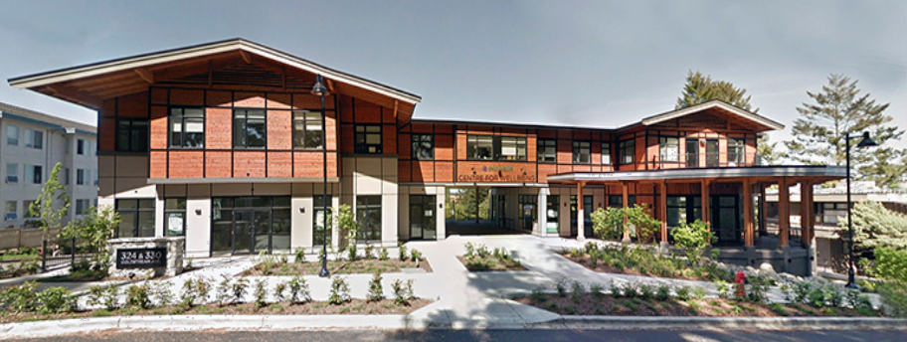
Hub and Spoke
PCFSA building in Colwood
Second floor
Notes:
We have a great space at the PCFSA building on Goldstream ave which is centrally located within the geography of the PCN.
As a non-profit organization with charitable status, the CHC will be able to apply for grants and other sources of funding to bring additional resources to the community.

Slide 11
Centrally located

