Slide 1

Gender affirming care of transgendered youth
Paul Kahlke
General Pediatrician
Pediatric endocrinologist
Cranbrook BC

Slide 2
Outline
Gender affirming Interventions
Non-medical
Puberty blocking
Cross hormones
Surgery

Slide 3
Declarations
No conflicts of interest
Off label medications – ALL of them
Acknowledgements – Dr. Dan Metzger

Slide 4
Terms
Transgender
  Trans-male
  Trans-female
  Non-binary/gender fluid
  Cis-gender
Gender dysphoria
(Forget gender identity disorder)
‘Ability to pass’

Slide 5
Interventions
 | Social | Puberty blockade | Cross hormone | Top surgery | Bottom surgery
Pre-pubertal | + | - | - | - | -
Early puberty | + | + | - | - | -
Late puberty | + | + | + | - | -
Post puberty | + | +/- | + | + | +

Slide 6
Non-medical interventions
Social transition
Psychotherapy
Non-surgical modifications

Slide 7
Pre-pubertal social transition?
“clinical experience suggests that persistence of GD/gender incongruence can only be reliably assessed after the first signs of puberty”
                The Endocrine Society
“help parents to weigh the potential benefits and challenges of particular choices.”
                WPATH Standards of Care

Slide 8
Psychotherapy
What it does:
  Help treat dysphoria
  Help explore gender expression
  Help navigate social aspects
  Treat co-existent mental health disorders
What it doesn’t do:
  Treat ‘gender identity disorder’
Available by:
  CYMH/CMHA
  Distance (list of providers from Transcare BC)

Slide 9
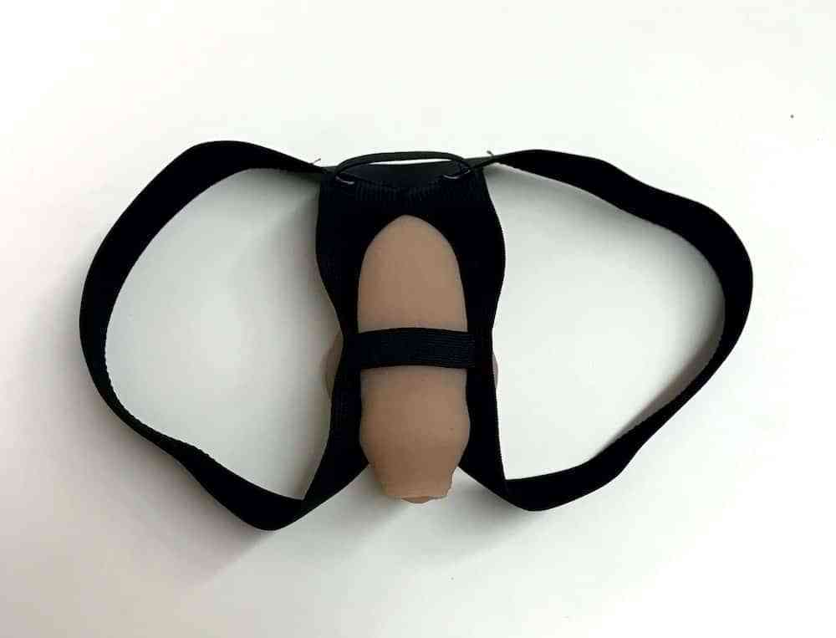

Non-surgical modifications

Slide 10
Outline
Gender affirming Interventions
Non-medical
Puberty blocking
Cross hormones
Surgery

Slide 11
Puberty blockers
“Neither puberty suppression nor allowing puberty to occur is a neutral act.”
              WPATH Standards of Care, 6th version

Slide 12
Goals
Provide
relief of gender dysphoria
Improve
physical outcomes
Improve
psychological outcomes

Slide 13
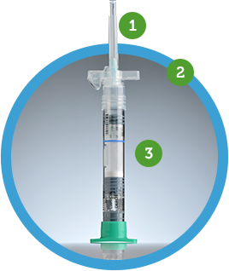
Puberty blocking
Lupron depot (off label)
  7.5mg q month
  11.25mg q 3 month
$400/month

Slide 14
Puberty blocking
Prevents
Breast development
Side effects
Local reactions
Fertility?
Penis/test enlargement
Facial/body shape changes
Transient worsening
Osteoporosis?
Menopausal sx
Menstruation

Slide 15
Puberty blocking timing
Early puberty– values decreased dysphoria and better physical outcomes
Mid puberty– lower risk of overtreatment

Slide 16
Outline
Gender affirming Interventions
Non-medical
Puberty blocking
Cross hormones
Surgery

Slide 17
Cross hormone Rationale
Decrease dysphoria -> improved mental health and QOL
Improve ‘ability to pass’

Slide 18


Feminizing
Therapy
(Height)
Facial structure/(Facial hair)
Voice/Adam’s apple
Muscle mass
Breasts
Decreased body hair
Bone structure
Body fat distribution
Penis

Slide 19
Feminizing protocol
Estrace 0.5mg PO daily (off label)
Increase over 2 years to 2mg PO daily
$14/month

Slide 20
Masculinizing
Therapy
(Height)
Facial structure
Voice/Facial hair
Muscle mass
Bone structure
Body fat distribution
Clitoral size
Cessation of periods

Slide 21
masculinizing therapy
IM:
Testosterone enanthate (Delatestryl) 50mg q2 weeks (off label)
Increase dose q 6 months to 200mg q2wks over 2 years
SC:
Testosterone enanthate (Delatestryl) – split dose weekly
$15/month

Slide 22
Side effects
Estrogen | Testosterone
Clotting | Cardiac risk
Breast cancer? | Male pattern baldness
Fertility? | Behaviour
 | Fertility?

Slide 23
Other endocrine options
Menses suppression
Spironolactone (off label)

Slide 24
Outline
Gender affirming Interventions
Non-medical
Puberty blocking
Cross hormones
Surgery

Slide 25
Top Surgery
MTF
  Breast implants
FTM
  Breast reduction
  Chest contouring

Slide 26
Bottom surgery
MTF
  orchiectomy
  penectomy
  vaginoplasty, clitoroplasty, vulvoplasty;
FTM
  hysterectomy/salpingo-oophorectomy
  Metoidioplasty vs. phalloplasty

Slide 27
Surgery – practical points
Cost – MSP covered for ‘top’ and ‘bottom’ surgeries but not others
Process
  Qualified assessors – 1 for top, 1-2 for bottom (none in the EKs)
  Top – Kamloops/Kelowna/other locations
  Bottom – Vancouver/Montreal – Gender Surgery Program BC
For more information:
  Crane center for transgender surgery
  GRS Montreal

Slide 28
EK Trans providers
Cranbrook
  Dr. Chris Pienaar (<19yo) – hormone readiness assessment
  Dr. Paul Kahlke (<36yo) – hormone initiation
  Tara Fiedler-Graham – hormone readiness assessment and hormone initiation
Creston
  Dr. Tara Guthrie – hormone readiness assessment and hormone initiation
Golden
  Dr. Jessica Chiles – hormone readiness assessment and hormone initiation

Slide 29
Where the rubber hits the road
Pre-pubertal
  refer to trans-care BC, CYMH, peds
  support is individualized
  social transitioning is controversial
Pubertal
  refer to trans-care BC, CYMH, peds
  may be seen and treated urgently
Post-pubertal – refer to trans-care BC, appropriate provider
  Individualized care

Slide 33
Cross hormone decisions
Is it the right thing?
Is it the right time?
  Age >14-16

Slide 34
Drummond et al., 2008 "##&; Wallien & Cohen-Kettenis, 2008 "##&
Follow-up studies have shown an undeniable beneficial effect of sex reassignment surgery on
postoperative outcomes such as subjective well-being, cosmesis, and sexual function (De Cuypere
et al., "##*; Gijs & Brewaeys, "##!; Klein & Gorzalka, "##%; Pfäfflin & Junge, $%%&). Additional
information on the outcomes of surgical treatments are summarized in Appendix D.

Slide 35
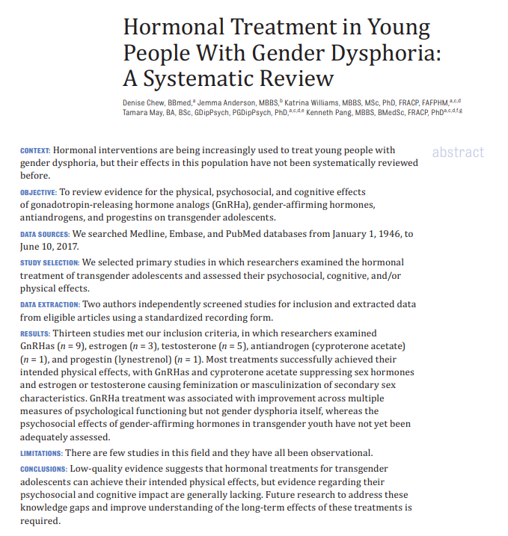

Slide 36
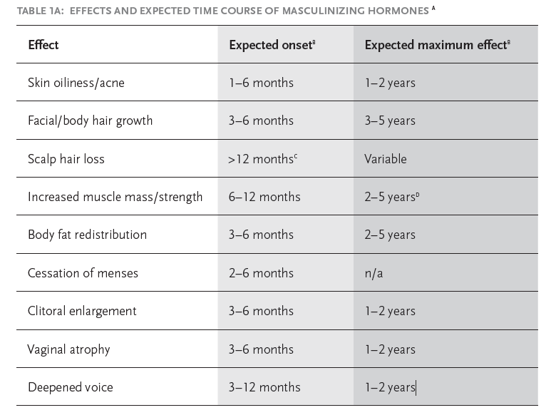

Slide 37
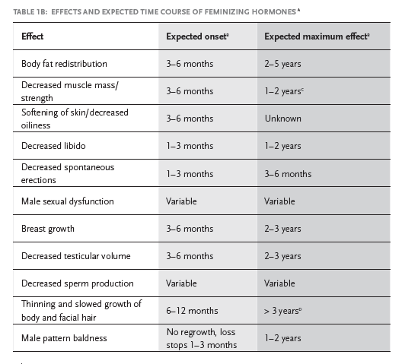

Slide 38
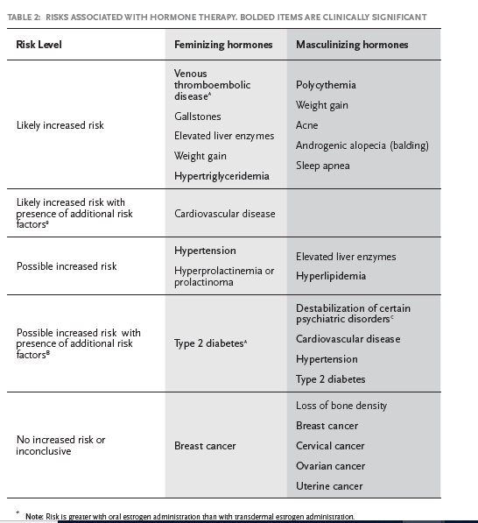

Slide 39
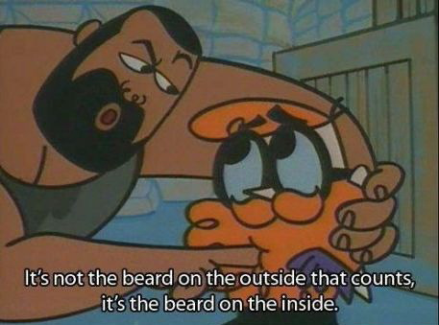

Slide 41
Endocrine society CPG monitoring
height, weight, BMI
pubertal development
bone age in growing kids
bone-mineral density
baseline and/or stimulated LH, FSH,testosterone/estradiol 
urea/creatinine, LFTs, lipids, glucose, A1C

Slide 42
Normal puberty
Girls:
  Breasts:10y (8–12)
  Growth spurt peak:11½ (9½–12½)
  Menarche:12½ (10½–14½)
Boys
  Testicular enlargement:11 (9–13)
  Growth spurt peak:13½ (11½–15½)
considerable variability

Slide 43
Estrogen effects
Non-permanent | Permanent | Not affected
Lower muscle mass | Breast (over several years) | Voice
Body fat distribution |  | Adam’s apple
Less body hair |  | Penis size
 |  | Beard

Slide 44
Duration
If starting cross hormones –
If not wishing to start cross hormones - ????

Slide 46
Cross hormone therapy criteria
Adolescents are eligible for subsequent sex hormone treatment if:
1. A qualified MHP has confirmed: ·the persistence of gender dysphoria, ·any coexisting psychological, medical, or social problems that could interfere with treatment (e.g., that may compromise treatment
adherence) have been addressed, such that the adolescent’s situation and functioning are stable enough to start sex hormone
treatment, ·the adolescent has sufficient mental capacity (which most adolescents have by age 16 years) to estimate the consequences of this
(partly) irreversible treatment, weigh the benefits and risks, and give informed consent to this (partly) irreversible treatment,
2. And the adolescent: ·has been informed of the (irreversible) effects and side effects of treatment (including potential loss of fertility and options to preserve
fertility), ·has given informed consent and (particularly when the adolescent has not reached the age of legal medical consent, depending on
applicable legislation) the parents or other caretakers or guardians have consented to the treatment and are involved in supporting
the adolescent throughout the treatment process,
3. And a pediatric endocrinologist or other clinician experienced in pubertal induction: ·agrees with the indication for sex hormone treatment, ·has confirmed that there are no medical contraindications to sex hormone treatment.

Slide 47
Puberty blocking: criteria
Adolescents are eligible for GnRH agonist treatment if:
1. A qualified MHP has confirmed that: ·the adolescent has demonstrated a long-lasting and intense pattern of gender nonconformity or gender dysphoria (whether
suppressed or expressed), ·gender dysphoria worsened with the onset of puberty, ·any coexisting psychological, medical, or social problems that could interfere with treatment (e.g., that may compromise treatment
adherence) have been addressed, such that the adolescent’s situation and functioning are stable enough to start treatment, ·the adolescent has sufficient mental capacity to give informed consent to this (reversible) treatment,
2. And the adolescent: ·has been informed of the effects and side effects of treatment (including potential loss of fertility if the individual subsequently
continues with sex hormone treatment) and options to preserve fertility, ·has given informed consent and (particularly when the adolescent has not reached the age of legal medical consent, depending on
applicable legislation) the parents or other caretakers or guardians have consented to the treatment and are involved in supporting
the adolescent throughout the treatment process,
3. And a pediatric endocrinologist or other clinician experienced in pubertal assessment ·agrees with the indication for GnRH agonist treatment, ·has confirmed that puberty has started in the adolescent (Tanner stage $G2/B2), ·has confirmed that there are no medical contraindications to GnRH agonist treatment.

Slide 48
Natural history
Pre-pubertal
Pubertal
Post-pubertal

Slide 49
“Why don’t all the other girls have penises?” – a 6yo natal male

Slide 50
              WPATH Standards of Care, 6th version
“The general goal of psychotherapeutic, endocrine, or surgical therapy for persons with gender identity disorders is lasting personal comfort with the gendered self in order to maximize overall psychological well-being and self-fulfillment.”

