Slide 1
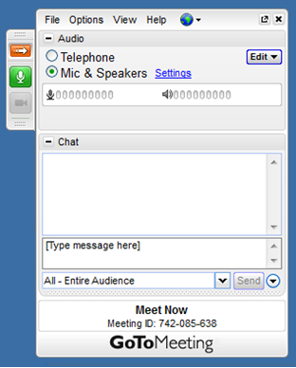
Welcome to the {WEBINAR NAME} Webinar
The webinar will start at {TIME}.
You may do a sound check
when you first log in, then please
mute yourself by clicking on the
green mic button:
If you’re having trouble
connecting to the audio, send a
message to the provincial team
through the chat window.

Slide 2
{WEBINAR NAME} Webinar
{DESCRIPTION OF WEBINAR TAG LINE}

Slide 3
Hand Raising
The hand raising feature is found on the left-hand side of the GoToWebinar control panel. By default, your hand will not be raised.
When your hand is down,
the button will look like this:
When you would like to contribute to the
discussion, click on the button to raise your hand. When your hand is raised it will look like this:

Slide 4
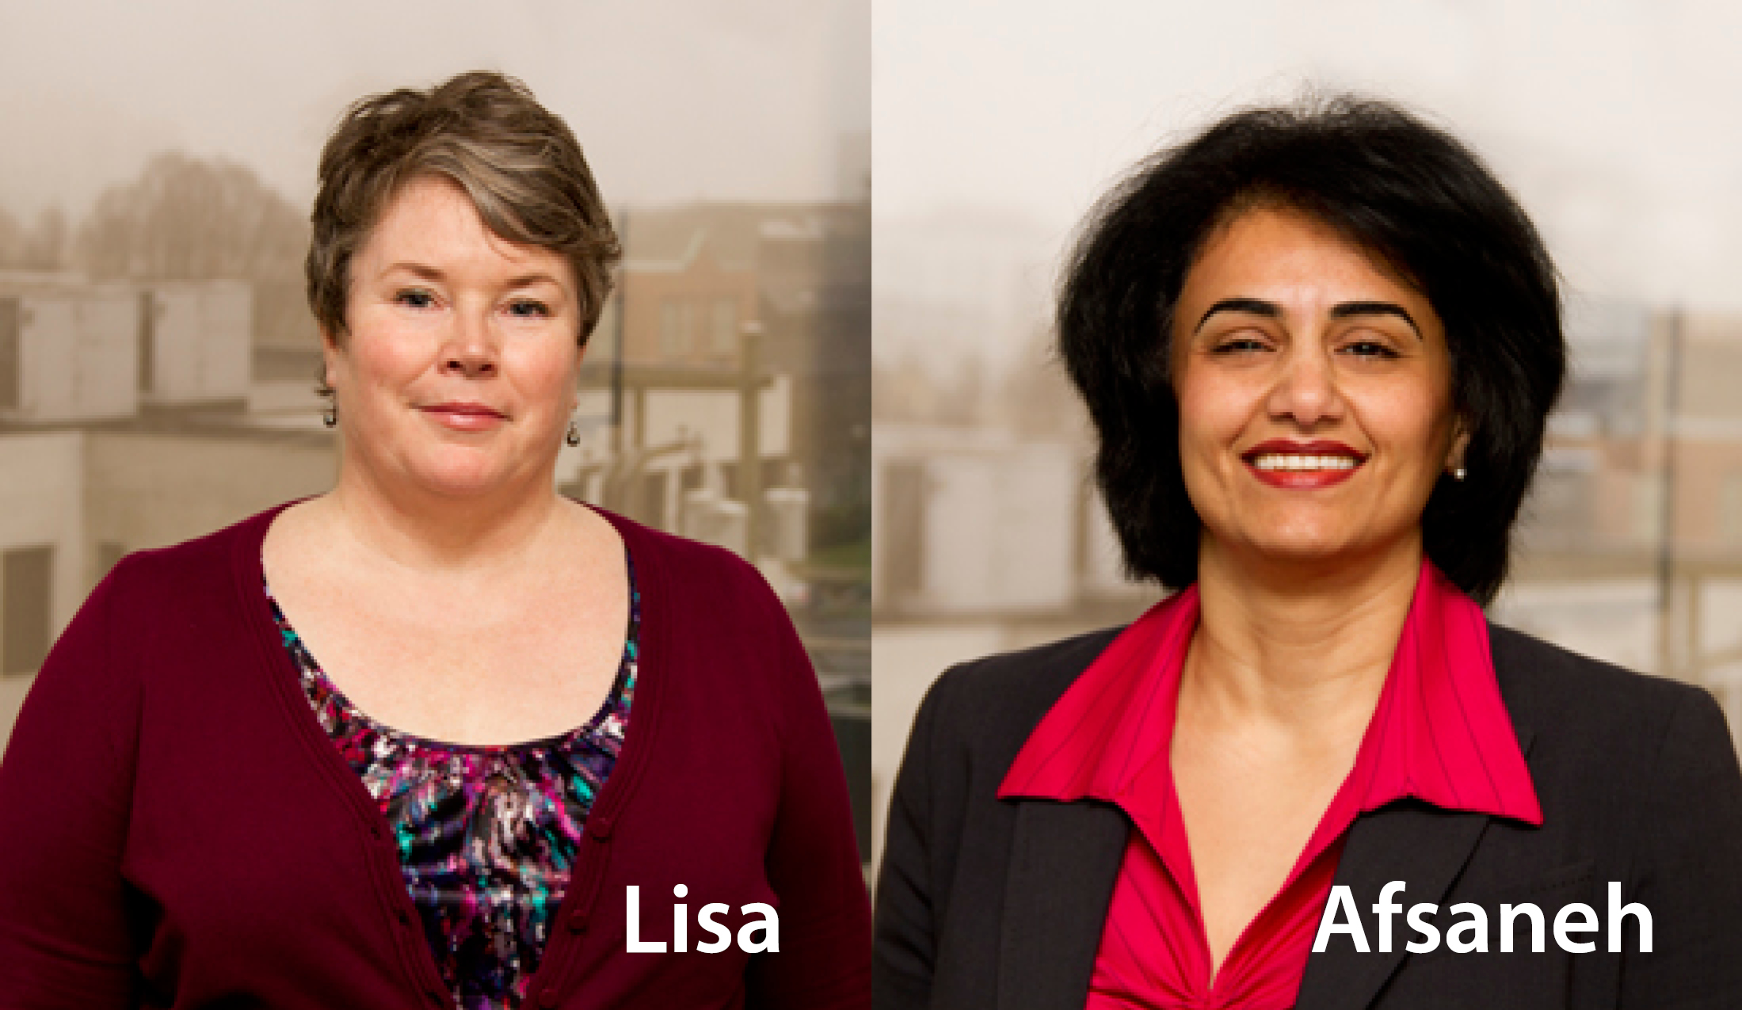
Presenters
Lisa Adams
Physician Engagement Leader
Afsaneh Moradi
Physician Engagement Leader

Slide 5
Thank you

